Slide 1
Early Market engagement – OWNER’s Engineer

Slide 2
FOREWORD
As we continue to move forward with our ambitious programme at Great British Nuclear, we are seeking to engage with key industry partners to shape the future of our delivery model. Our programme represents a significant opportunity for collaboration in the nuclear sector, and we are eager to work with capable partners who share our vision of making new nuclear projects happen to bring secure, reliable and sustainable energy to the UK whilst retaining a culture of collaboration and safety, both of which are paramount to GBN’s vision.
This engagement marks an important step in our early market approach, designed to create a transparent and open dialogue with potential Owner’s Engineer providers. In this pack, you will find an introduction to GBN and an overview of our SMR programme objectives. A more detailed section follows, outlining the key responsibilities and complexities associated with the role of Owner’s Engineers within this context. We recognise that this role requires a high level of technical expertise, and we are committed to ensuring that our approach reflects the capabilities and insights of the market.
Finally, we have included a series of questions aimed at understanding the market's appetite for involvement in our programme. These questions will help us gather intelligence that may influence our procurement strategy and ensure that the delivery model we construct is aligned with the industry's strengths and capabilities.
We encourage all participants to engage openly and provide thoughtful responses to the questions posed. Your insights will be invaluable as we continue to refine our approach and lay the groundwork for a successful partnership. We look forward to hearing from you and exploring opportunities to collaborate on this exciting venture.
Thank you for taking the time to review this early market engagement pack. We appreciate your participation and look forward to your feedback.
Beverley Grey
Commercial Director, Great British Nuclear

Slide 3
CONTENTS
SECTION 1
Purpose of this Engagement
06
SECTION 2
Introduction to GBN
09
SECTION 3
Introduction to the SMR Project
11
SECTION 4
Proposed Enterprise Model
16
SECTION 5
Proposed Scope and Role Profiles
19
Proposed Delivery Approach
30
SECTION 6
Proposed Commercial Structure
SECTION 7
32
SECTION 8
GBN Questions for Participants
38
SECTION 9
Next Steps
44
Addendum Slides
SECTION 10
46

Slide 4
Glossary
Acronym | Term
COD | Commercial Operation Date
DevCo | Development Company
DESNZ | Department for Energy Security and Net Zero
DP | Delivery Partner
FID | Final Investment Decision
FOAK | First Of A Kind
GBN | Great British Nuclear
GW | Gigawatt
HMG | His Majesty’s Government
LOD | Line of Defence
OE | Owner’s Engineer
PM&I | Project Management & Integration
PMO | Project Management Office
SMR | Small Modular Reactor
TP | Technology Partner (including Responsible Designer)

Slide 5
DISCLAIMER
Participants shall be responsible for and bear their own costs, charges and expenses relating to the preparation and expression of interest in this market engagement.
Participants are bound by the terms of the Non-Disclosure Agreement entered into prior to receiving this early market engagement pack. In respect of Owner’s Engineer market engagement, save as specifically permitted by the terms of the NDA, such information must not be copied, reproduced, distributed or passed to any other person at any time.
This market engagement exercise is an informal exercise and does not indicate a commitment to progress to a procurement, contract or other commercial activity.

Slide 6
PURPOSE OF THIS ENGAGEMENT
1

Slide 7
1.1 Purpose of this engagement
Great British Nuclear (GBN) is seeking to informally obtain early market feedback on its proposed approach to procuring up to two Owner’s Engineers.
This pack aims to provide a brief introduction to GBN and the Owner’s Engineer approach being considered, to secure near- and long-term independent assurance capability which is a key function within the proposed delivery model.
This exercise aims to provide necessary background information to participants to support their submission of responses.
Feedback will be utilised to help inform GBN’s intended approach to evolving the Owner’s Engineer delivery model by building upon our understanding of key factors that will shape it, including but not limited to: scope, risk, conflicts of interest, commercial contracting and associated procurement process, collaboration and incentive mechanisms.
This pack includes questions in relation to which GBN is seeking a response from participants.
Any documentation issued by GBN as part of this current Early Market Engagement exercise will also be published at the time of a formal procurement process to ensure equality of information to non-participants in this exercise.
Note: The information contained within this pack reflects the current options under consideration by GBN. We reserve the right to amend and/or update the Owner’s Engineer delivery model and these options in future.

Slide 8
1.2 timeline
Nov 24 | Dec 24 | Jan 25 | Feb 25 | Mar 25
Issue Invitation and NDA
Execution of NDAs
Issue of Early Market Engagement Information Pack
Supplier Review and Response Time [15 working days]
GBN Review of Responses
GBN/Supplier 1:1 engagement as required
GBN Post Engagement Review
Conclusion of Early Market Engagement
Nov 24 | Dec 24 | Jan 25 | Feb 25 | Mar 25

Slide 9
INTRODUCTION TO GBN
2

Slide 10
2.1 Introduction to great British nuclear
GBN was officially launched in 2023 to rejuvenate the UK’s nuclear industry and drive forward the delivery of the nuclear programme.
https://www.gov.uk/government/publications/civil-nuclear-roadmap-to-2050

Slide 11
INTRODUCTION TO THE SMR PROJECT
3

Slide 12
3.1 Introduction to the smr project
SMR Programme Objectives
GBN’s Portfolio objectives are to deliver (up to) 24GW of New Nuclear generating capacity by 2050.
GBN’s SMR Programme objectives are to:
Demonstrate that SMRs can be deployed reliably, quickly and in a repeatable manner, supporting future fleet deployment.
Deliver up to two SMR projects progressing to Financial Investment Decision (FID), with a view to COD in the mid-2030s
Promote the growth of the UK’s nuclear development capability and market.
Address the delivery challenge faced by the nuclear industry by:
reducing the overall capital cost,
reducing overall construction risk and length utilising modern methods of construction,
streamlining design replication.
Support the inclusion of a significant proportion of systems and structures designed for modularisation, factory assembly and flexible logistics solutions.
Procure SMR technologies within delivery models that benefit Social Value imperatives.
Deliver a robust project framework underpinned by key regulatory, economic and commercial considerations in laying a credible basis for future, repeatable SMR deployment, in order to attract private sector investment for both the FOAK project(s) (private finance at FID being an objective) as well as future fleets.
DESNZ
GBN
SMR Programme
Other Programmes (future TBD)
SMR Project 1*
SMR Project 2*
*GBN reserve the right to award up to 4 projects, but GBN’s intent is to award 2.

Slide 13
3.2 SMR Project Phases, Tranches and Milestones
Phases
1. Initiation
2. Definition
3. Execution
4. Operations
Tranches
1. Project Establishment
2a. Initial Planning
2b. Detailed Planning
3a. Non-nuclear Construction
3b. Nuclear Construction
3c. Commissioning
4. Operations
Milestones
Financing
Organisational
Project Delivery
Tranche 1 | Tranche 2a | Tranche 2b | Tranche 3a | Tranche 3b | Tranche 3c | Tranche 4
The project is defined, delivery team is established, governance structures are put in place, key roles and responsibilities are assigned and resource mobilisation is underway. | The project design is moved through concept and preliminary stage, with fundamental design decisions agreed, initial safety principals established, and early planning for delivery (including identification of long lead items) is underway. Design maturity commensurate to support the early needs of the planning and consenting programme is delivered. | The detailed design is completed, along with supporting safety, security, and environmental justifications. All necessary works to support early site mobilisation, procurement of delivery contracts, and delivery estimates of cost, schedule and risk are completed. | All necessary site works to support nuclear construction are completed, including site preparation, enabling works, associated developments and bulk earthworks. | The SMR plant is constructed, assembled, manufactured and installed on site, along with the completion of all other main project construction works. | The plant is commissioned, with nuclear fuel loaded and grid synchronisation completed. The operating organisation is fully developed in preparation for commercial operations. | The SMR plant enters commercial operation and is operated and maintained for its lifetime.
Final Investment Decision
MM2
MM3
MM4
Project Initiation Stage Gate
Preliminary Design Complete Stage Gate
Detailed Design Complete Stage Gate
First Nuclear Construction
Commercial Operations

Slide 14
3.3 Introduction to the smr project
GBN’s intent initially is to deliver up to two SMR projects. The intention is that there will be one DevCo appointed in respect of each SMR project, which
will be initially formed within GBN.
A strategic decision will be taken prior to/around FID for one DevCo per technology/SMR project, based on; scale, requirement for single focus and to ‘ring-fence’ individual TP’s IP/know-how to safeguard value leakage.
(Future state)
GBN
DevCo 1
DevCo 2
Potential trigger points for the transition:
Nuclear Site Licence requirements driving need for SMR project standalone capability pre-FID
The introduction of private finance requiring a DevCo special purpose vehicle for the privately financed project.
SMR Project 1
SMR Project 2
SMR Project 1
SMR Project 2
Technology Partner 1
Technology Partner 2
Technology Partner 1
Technology Partner 2
Start state:
GBN launch individual SMR integrated project teams (journey to FID).
Structured from the outset with the intent to transfer into two DevCos at appropriate point
Future state:
Individual DevCos to manage the delivery of either an SMR project post-FID or a subsequent fleet of SMRs of the same technology.
Delivery Partner and supply contracts operate within respective project(s)

Slide 15
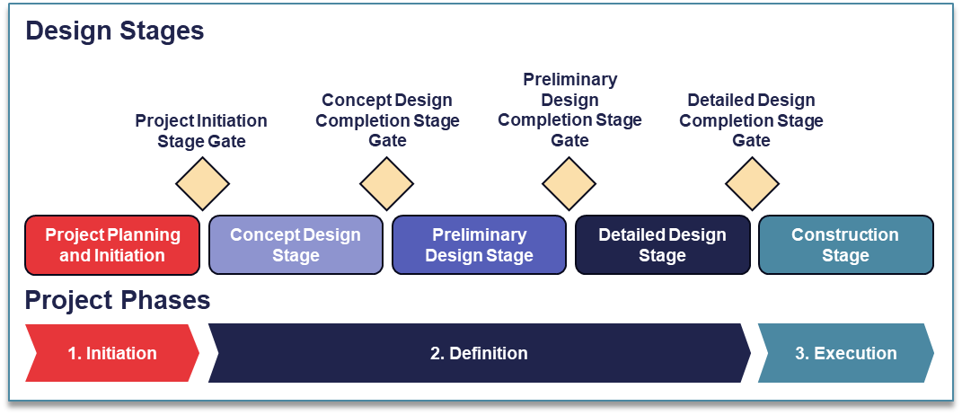
3.4 Gateway reviews

Slide 16
PROPOSED ENTERPRISE MODEL
4

Slide 17
4.1 Enterprise model hierarchy
Organisation | Description | Role(s) | Primary Responsibilities
DESNZ | DESNZ sets the policy and strategic direction and approves business case(s) | Strategic governance Programme sponsor | Policy and legislation development
GBN | GBN secures the funding, generates and owns the business case, specifies requirements for DevCo (Client), and holds DevCo accountable for delivery | Project sponsor Programme owner | Technology selection Site selection and acquisition SMR programme management Project DevCo establishment
Project DevCo (DevCo Client) | DevCo (the Client) is responsible for delivering the outturn benefits required by GBN. (This will initially be undertaken by GBN until the function is transferred to DevCo) | Project developer Overall project integrator Nuclear Site Licensee Design Authority Intelligent Customer / Intelligent Client | Securing project finance Procurement of Project Agreements Safety / environmental / security case ownership Securing necessary planning consents and permits Future plant Operations
Delivery Partner (DP) | Organisation that works with the DevCo in specific capacities providing key project delivery capability which may include technical and delivery integration of the full scope. | Project Director Delivery Integrator Technical Integrator Supply Chain Integrator | Delivery Integration (PM, PMO, H&S) Commercial Management & Procurement Baseline & Change Management Construction Management Technical Integration & Interface management
Supply Chain | Organisation(s) appointed by the DevCo to deliver the project in line with requirements | Construction Engineering | Non-nuclear Design Construction
DESNZ
GBN
Project DevCo (DevCo Client)
Enterprise Hierarchy
Delivery Partner
Supply Chain

Slide 18
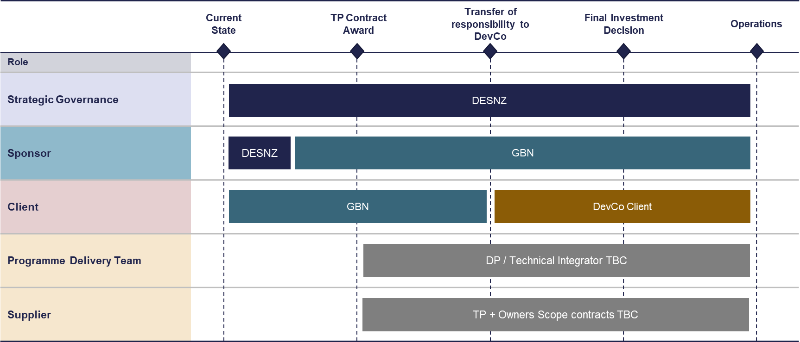
4.2 Enterprise Model evolution
Transition of role in the Enterprise model
Foundation Capability

Slide 19
PROPOSED SCOPE AND ROLE PROFILES
5

Slide 20
5.1 Outline of Role of OWNER’s Engineer(s)
The OE will be stood up alongside the foundation organisation and will transition to support the DevCo enduring capability.
It is expected that the OE will perform the following role(s), having DevCo’s interest as their primary focus as the client friend:
Provide independent comment on technical and commercial aspects of the project (e.g. cost, schedule, risk).
Be the DevCo Intelligent Customer’s independent expertise provider, with the OE developed in a collaborative manner whilst DevCo retains the controlling mind. Where appropriate, this may include LOD2 assurance and support decisions relating to scope, budget, risk, delivery, and contract compliance, supporting deep dives into areas of perceived high risk.
Provide independent advice to changes/decisions above LOD1 delegated levels of authority that require approval as part of governance process.
Supplement the DevCo Intelligent Customer-employed capability by having access to industry appropriately trained and experienced professionals, including access to independent light water reactor technology knowledge.

Slide 21
5.2 Outline of Scope of owner’s engineer(s)
It is anticipated that the selected OE will work with the IC to develop a schedule of planned activities and remain available to support emergent and unscheduled activities. SMR TPs have not been selected, and SMR project baseline schedules have not been set. Therefore, the scope of the OE is at an outline definition in relation to the programme sections below; these core services are relevant to the whole scope of the Project (i.e. TP and non-TP).
Design Assurance
OE Scope Coverage
Construction
Review of the Contractor(s) Master Information Delivery List and identification of deliverables to be submitted for review / approval in support of the IC.
Review and acceptance of project deliverables in support of the IC.
Assurance of compliance of design deliverables
Assurance of changes/deviations to design submissions and audit reports.
Assurance of compliance with the Client’s Requirements and Contractor’s Proposal.
Assurance of compliance with planning/consenting conditions.
Assurance of compliance with additional requirements, as applicable.
Attendance at key design and safety reviews / milestones, including project gated reviews, constructability reviews, HAZOP reviews, Control of Major Accident Hazards (COMAH) reviews, and Construction Design and Management (CDM) reviews.
Support to the management of Project requirements, including technical advice on any changes to these requirements throughout delivery.
Review and technical support to the production of contracts / technical specifications / performance requirements for Owner’s Scope work packages.
Assurance on construction and commissioning activities to ensure compliance with all relevant requirements.
Review of Inspection and Test Plans (ITPs) (or equivalent) covering manufacturing, assembly, construction activities and identification of key witness and hold points.
Attendance at manufacturing and assembly witness and hold points.
Attendance at site to monitor and review construction and commissioning progress, including attendance at key activities and milestones during construction and commissioning (including work package handovers).
Review of key construction and commissioning documentation (records, certificates, quality assurance documentation etc.).
Review of relevant takeover documentation and assurance that this documentation meets all client, end user, and external stakeholder requirements.
Additional Resource Support
Provision of ad-hoc technical and delivery support resources as needed by the Client to support / supplement the client capability at various times during the delivery of the project.
Review and assure any Contractor proposals on behalf of the IC, including any suggestions for improvements to technical requirements to help GBN assess whether they should be integrated or not.
Assistance in the preparation of any technical documentation required for the IC to demonstrate their position if requested by external stakeholders.
Delivery
Assurance of delivery compliance with Project requirements, including schedule, quality arrangements, HSE arrangements etc.
Review and support to the production of contracts / specifications / performance requirements for Owner’s Scope packages.
Review of weekly/monthly progress reporting from the Contractor(s).
Assurance of integrated project estimates of time, cost, and risk.
Review and support with the IC’s strategic risk identification and mitigation planning.

Slide 22
5.3 Outline Capabilities of owner’s engineer(s)
The appointed Owner’s Engineer(s) would be expected to evidence the following capabilities:
TECHNICAL
PROGRAMME DELIVERY
1. Chemistry
2. Civil Engineering
3. Control & Instrumentation
4. Criticality
5. Protective/Cyber Security (incl. Security by design)
6. Decommissioning
7. Electrical Engineering
8. External Hazards
9. Fault Studies
10. Fuel & Core Design
11. Human Factors
12. Internal Hazards
13. Leadership and Management for Safety, Supply Chain and Quality
14. Mechanical Engineering
15. Safety Case Analysis and Techniques (incl. Safety by design)
16. Severe Accident Analysis (SAA)
17. Probabilistic Safety Analysis (PSA)
18. Radiological Protection and Emergency Planning & Response
19. Radioactive Waste Management
20. Reactor Core Physics
21. Safeguards (incl. Safeguards by design)
22. Structural Integrity
23. Requirements Management
24. Environmental Protection
25. Engineering Management
26. EQ
27. BAT
28. System Engineering
29. Conventional Waste
30. Construction, incl. CDM
31. Commissioning
32. Radiation Protection Advisors
33. Training
34. Operator Capability
1. Full SMR plant lifecycle
2. Planning and Scheduling
3. Cost Estimating and Cost Management
4. Risk Management
5. Scope Management
6. Change Management
7. NEC Contracts
*This is a non-exhaustive list at present.

Slide 23
5.4 guiding principles
The SMR Project OE role is to support the DevCo to ensure that:
The project is licensable, investible and deliverable to specification and schedule - supporting DevCo to minimise costs, by bringing well-co-ordinated sustainable capability, experienced in delivering value for money nuclear technology projects.
The design is managed and developed effectively, with nuclear safety, radiological safety or the security of nuclear materials significant work carried out to the required level of Safety, Security, Safeguards, Environmental protection (SSSE) and quality by demonstrably suitably competent adequate resources, underpinned by a management system that promotes a positive SSSE culture, learning and relevant standards.
The understanding and maintenance of the design intent and its safe operating envelope is maintained through the plant delivery lifecycle into construction, commissioning, and operations, meeting the expectations of UK regulatory relevant good practice, whilst avoiding preferential engineering.
The contractor (e.g. TP and other contractors) deliverables are robust through effective review, representing DevCo (where delegated), and later where appropriate, supporting negotiations, audit, procurement activities and independent evaluation

Slide 24
5.5 Conflicts of interest
GBN is aware of the potential participation of some organisations and their supply chains in the Technology Selection Process, and other GBN procurements such as the Owner’s Engineer, Foundation Project Management and Commercial Capability, Project Delivery Partner, Foundation Engineering Capability and Civils/Infrastructure.
As such, GBN intends to include additional rules relating to the management of actual, potential, and perceived conflicts of interest in some of its upcoming procurements to facilitate the DevCo Delivery Model. These rules will be clearly set out at the Invitation to Tender stage.
GBN considers that it will be necessary to include these additional rules due to the interdependencies as between certain contracts and, in particular, in some cases GBN will be appointing contractors who will be responsible for performing an oversight role.
For example, both the Owner's Engineer and Project Delivery Partner will be responsible for managing certain aspects of the performance of the TP Contract. Therefore, to avoid conflicts of interest, GBN proposes that the TP for a Project cannot also be the Owner's Engineer or Project Delivery Partner for that Project.

Slide 25
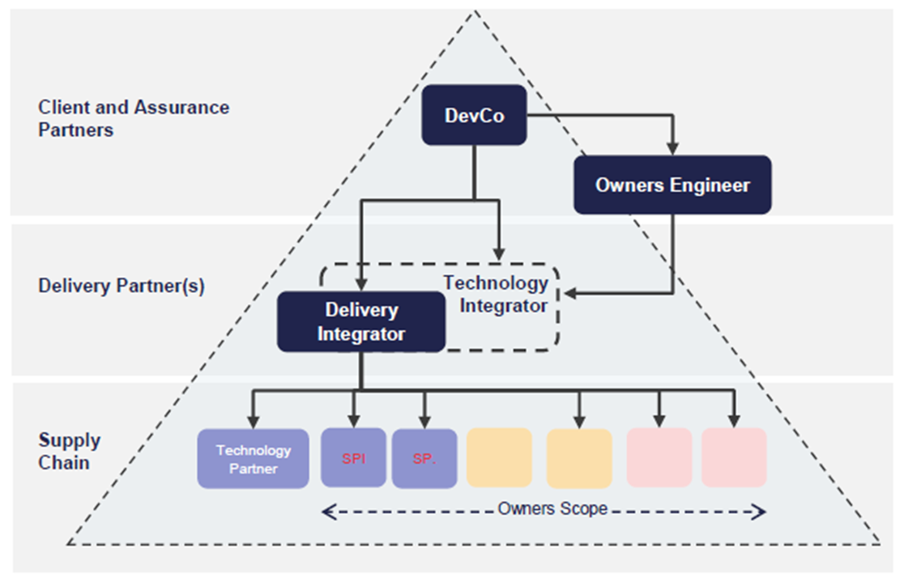
5.6 role profiles | overview
CONCEPTUAL SMR PROJECT DELIVERY MODEL
The scope of this early market engagement exercise relates to the Owner’s Engineer construct.
Intelligent Client & Assurance Partner
Delivery Partner(s)
Suppliers
DevCo Enterprise
DevCo
Intelligent Customer/Client
DA
Owner’s Engineer (Technical + Delivery)
Delivery Partner
Technical Integrator
Procurement & Contract Mgmt
Delivery Management & Project Controls
Delivery Integration
Technical Assurance
Delivery Assurance
SP1
SP2
Technical Integration
(Could be part of Delivery Partner depending on option selected)
Supply Chain Packages (to be defined and procured)
Technology Partner
Other Suppliers
(Owner’s Scope)

Slide 26
5.7 DEVCO ROLE profiles | OWNER’S ENGINEER
CONCEPTUAL SMR PROJECT DELIVERY MODEL
ROLE, AND OUTLINE SCOPE OF SERVICES
Delivery Partner(s)
Suppliers
The Owner’s Engineer plays the role of subject matter experts to support independent technical and delivery LOD 2 assurance on major design and build contracts. The OE acts as a ‘client friend’ on the technical side of the project, supporting decisions relating to scope, budget, risk, delivery, and contract compliance, supporting deep dives into areas of perceived high risk.
Enabling | Provide support on safety cases, NSL. environment & security cases, permitting, licensing, asset management, etc. Provide assurance to changes/decisions above LOD1 delegated levels of authority that require approval as part of governance process. Deliver assurance and advice to enable the ‘delivery enterprise’ to be successful, and when necessary, provide support/advice to help mitigate emerging risks. Provide independent LOD2 assurance to technical design and project delivery (e.g. cost and schedule estimating)
Supporting | Provide support on developing environmental strategy, digital strategy, IMM strategy, etc.
Project Delivery | Provide necessary technical oversight of any Partner(s) / supply chain providing Project and Technical services Provide technical oversight to engineering design, constructability, modularisation and configuration management Act as DevCo representative (where appropriately delegated) at technical hold points, design reviews, H&S reviews, construction, testing and commissioning activities Provide technical support to the intelligent client on strategy development, key technical standards definition and high-level project requirements development
DevCo Enterprise
Intelligent Client
DevCo
Intelligent Customer/Client
DA
Assurance Partner
Owner’s Engineer (Technical + Delivery)
Delivery Partner
Procurement & Contract Mgmt
Delivery Management & Project Controls
Delivery Integration
Technical Assurance
Delivery Assurance
Technical Integration
(Could be part of Delivery Partner depending on option selected)
Technology Partner
Other Suppliers
(Owner’s Scope)

Slide 27
5.8 ROLE profiles | Devco intelligent client/Customer
CONCEPTUAL SMR PROJECT DELIVERY MODEL
ROLE, AND OUTLINE SCOPE OF SERVICES
Delivery Partner(s)
Suppliers
The Intelligent Customer/Client is the licensee, owner and a potential future operator of the SMR plant. They must be focused on delivering ‘successful’ major infrastructure aligned to Sponsor expectations and capable of specifying requirements to all key contracting parties and managing delivery outcomes. It will do so by owning strategies, procuring the right partners, and setting clear objectives and requirements of partners to deliver against, whilst providing supporting functions for overall SMR project delivery.
Enabling | Own/manage the project interface with the ONR/EA and other regulatory bodies. Provide LOD2 commercial assurance Provide ownership and oversight of regulations compliance, consents, construction licensing & permitting Discharge CDM duties (incl. appointing PDs & PCs, defining interfaces for PDs & PCs, and conducting competency assessments) Develop and own strategies related to safety, health, security & environment and quality Apply for and hold, the Nuclear Site Licence (NSL), including development and maintaining necessary safety capabilities to act as responsible licensee (including Design Authority)
Supporting | Provide financial management and planning services for SMR project (financial modelling, budgeting, reporting, funding, etc.) Provide corporate services, around HR, Finance, IT, Business Change (aligned with broader GBN services across DevCos) Develop and own strategies related to ESG, EDI, digital and IMM Develop HMT business cases and manage ext. stakeholder engagement, comms & approvals Set commercial and procurement strategy incl. partner incentivisation, procure partner contracts Establish the necessary organisational capabilities and governance arrangements to discharge the requirements of Nuclear Site Licence (NSL) and other relevant permits and consents
Project Delivery | Manage internal and external commercial governance Manage Partner contracts & agreements Define SMR project objectives, partner KPIs, review & endorse supply chain KPIs and incentivisation Own and manage L0 project controls activities (cost, risk and schedule) Provide oversight on SMR project management and supply chain management, project controls, integration & construction delivery Define SMR operations & requirements (operations & maintenance) and develop operational readiness, licensing and transition management plan
DevCo Enterprise
Intelligent Client
DevCo
Intelligent Customer/Client
DA
Owner’s Engineer (Technical + Delivery)
Delivery Partner
Procurement & Contract Mgmt
Delivery Management & Project Controls
Delivery Integration
Technical Assurance
Delivery Assurance
Technical Integration
(Could be part of Delivery Partner depending on option selected)
Technology Partner
Other Suppliers
(Owner’s Scope)

Slide 28
5.9 role profiles | delivery partner
CONCEPTUAL SMR PROJECT DELIVERY MODEL
ROLE, AND OUTLINE SCOPE OF SERVICES
Intelligent Client & Assurance Partner
Delivery Partner(s)
Suppliers
The Delivery Partner provides overall delivery integration and management, covering the full scope of the SMR project. This includes integration, co-ordination, interface management, LoD1 assurance, and management of project baselines of cost, risk, scope, and schedule. Although the DevCo will likely be the contractual counterparty for the supply chain contracts, the Delivery Partner will project manage and integrate delivery of these contracts.
Enabling | Provide LOD1 technical, delivery and commercial assurance of suppliers’ delivery Support the intelligent client (IC) on managing regulatory interfaces and obtaining required NSL, consents and permits Manage and coordinate necessary inputs to support licencing activities from Suppliers Develop and implement SMR project strategies/plans to control safety, quality, and the environmental aspects of the project, in compliance with DevCo IC policies, ensuring the Suppliers comply with these arrangements in delivering their work.
Supporting | Provide necessary inputs to supporting functions, including funding approvals (e.g. programme business cases), benefits realisation and corporate reporting. Manage Supplier payments on behalf of IC Implement DevCo Enterprise policies and strategies within its own teams, and the Supply Chain Provide support to IC where needed (e.g. definition of IT systems requirement, development of operation readiness plan, aligning suppliers to SMR project culture, managing benefits realisation, etc.) Manage and report on DP KPIs and supplier KPIs
Project Delivery | Manage project delivery within delegated authorities and reporting into project governance Deploy management arrangements (including associated systems and tools for example contract management) to ensure effective delivery integration and manage interfaces between Suppliers including Engineering and Design packages (the current model does not include a requirement for non-nuclear design. This is being provided by a separate supplier.) Manage supplier contracts and commercial incentives in conjunction with IC Provide support to IC where needed (e.g. development of packaging and procurement strategies, development of project delivery strategies, supplier procurement activities, etc.) Manage Procurement activity on behalf of the DevCo Manage supplier delivery against SMR project strategies and ensure requirements compliance Review constructability and modularisation and manage construction planning and logistics Certify works completion and acceptance aligned to supplier contract scope Provide project management and project controls (L1+) to ensure integrated management and delivery.
DevCo Enterprise
DevCo
Intelligent Customer/Client
DA
Owner’s Engineer (Technical + Delivery)
Delivery Partner
Procurement & Contract Mgmt
Delivery Management & Project Controls
Delivery Integration
Technical Assurance
Delivery Assurance
Technical Integration
(Could be part of Delivery Partner depending on option selected)
Technology Partner
Other Suppliers
(Owner’s Scope)

Slide 29
5.10 ROLE profiles | suppliers
CONCEPTUAL SMR PROJECT DELIVERY MODEL
ROLE, AND OUTLINE SCOPE OF SERVICES
Intelligent Client & Assurance Partner
Delivery Partner(s)
Suppliers
The Supply Chain, consisting of the Technology Partner, Technical Integrator (could be part of Delivery Partner dependent upon option selected) and other suppliers providing Owner’s Scope, is responsible for the delivery of the integrated technical design and supply of the SMR Plant, delivered in accordance with the requirements of the DevCo and under the management of the Delivery Partner.
Enabling | Provide LoD 0 technical, delivery and commercial assurance (i.e. self-assurance) of their own delivery activities Provide necessary inputs, including safety case contributions, to support the DevCo on its activities. Comply with requirements of all relevant permits and consents Comply with CDM regulations and SMR project strategies and requirements
Supporting | Comply with management arrangements and strategies set by DevCo and DP in the delivery scope Provide project information and reporting as required
Project Delivery | Deliver all scope required for design and construction of the SMR Project(s) aligned to DevCo’s requirements and standards Manage and coordinate all design and construction within contract boundaries Comply with all relevant project delivery processes and procedures Identify technical interfaces and manage technical integration for design, construction, installation & commissioning for all TP / Supplier interfaces (where not managed within TP / Supplier contract boundaries) Deliver testing, commissioning and validation of direct and sub-contracted scope Management of subcontracted scope delivery Provide inputs into Project Controls as required by the DP (typically at L3+) Support DP on integrated planning, interface management, inter-contract management, site-wide construction logistics management Manage construction logistics for direct and sub-contracted scope
DevCo Enterprise
DevCo
Intelligent Customer/Client
DA
Owner’s Engineer (Technical + Delivery)
Delivery Partner
Procurement & Contract Mgmt
Delivery Management & Project Controls
Delivery Integration
Technical Assurance
Delivery Assurance
Technical Integration
(Could be part of Delivery Partner depending on option selected)
Technology Partner
Other Suppliers
(Owner’s Scope)

Slide 30
PROPOSED DELIVERY APPROACH
6

Slide 31
6.1 Proposed delivery approach Options
It is expected that each OE will provide a ‘Core Team’ to build the relationship and act as the bridge between the OE and the IC. The ‘Core Team’ will primarily:
Manage the master schedule of OE activities (including collaboration with the IC on identification of ‘drumbeat’ activities and response to short notice and unplanned activities).
In collaboration with the IC, estimate the scope for task sheets required to conduct OE activities.
Maintain the OE capability/resource database, including personnel training/experience/competence and conflict of interest.
Project manage the Consultant’s provision of the OE capability.
The expectation is that these individuals should be experienced in assurance of infrastructure project delivery with excellent leadership skills and are confident working across multiple disciplines, including engagement with legal, finance and commercial workstreams.
The IC and OE may agree to review and revise the Core Team over the contract duration as requirements develop. The OE may propose additional responsibilities for a Core Team that effectively and efficiently meets the requirements of the scope of this contract.
The Core Team will co-ordinate and oversee requirements for Subject Matter Experts (SMEs) from within the Supplier’s organisation or subcontracts. Whilst the OE is expected to provide a consistent level of support to GBN throughout the length of the contract, the use of reach-back capability from SMEs will flex in line with the activities being undertaken at different stages.
The OE will be required to flex their resource to meet the IC’s requirements based on an annualised schedule that they will work collaboratively to determine. These annualised schedules will form work packages which the IC will issue to the OE (in alignment with the end of the financial year).
The IC will ‘call-off’ against the skills, capabilities and activities listed in the OE Specification to deliver the work packages as they are defined. This allows the IC to rely on the OE’s flexibility to support emergent and unscheduled LOD2 activities in addition to those anticipated and scoped.
Any consultant must be able to implement both a dedicated OE function to provide consistent interpretation and approach to OE activities, whilst also demonstrating sufficient flexible reach-back that will add expertise in a wide range of areas as required.

Slide 32
PROPOSED COMMERCIAL STRUCTURE
7

Slide 33
7.1 Proposed contracting model
GBN intends to adopt a traditional contracting arrangement for Stage 1 (Design) of the SMR Programme – Delivery Partner(s) integrating the supply chain contracts and will manage each contract individually.
The Owner’s Engineer will have a contractual relationship solely with GBN/the DevCo.
Traditional Contracting Arrangement ​
The DevCo is the primary contracting entity. In this arrangement, the Owner’s Engineer has a contractual relationship with only the DevCo, who itself has contractual relationships with the suite of supporting contracts involved in the SMR programme.​
DevCo
Owner’s Engineer
Supporting Contracts

Slide 34
--:--
7.2 PROCUREMENT approach Options
The procurement route will take an option under the new Procurement Act 2023 (due to ‘go live’ in Oct ’24 although HMG has announced a new date for the commencement of 24 February 2025) the choices of Open Procedure and Existing Frameworks will also be considered.
Approach Description | Advantages | Disadvantages | Timescales | Suitability for the Owner’s Engineer procurement
Open Procedure | Contractual Autonomy Access to the whole market Straightforward and quicker than competitive flexible | Higher administrative burden Lacks flexibility of Competitive Flexible | Generally, a minimum period of 25 days at tender stage (without pre-qualification), but in practice, the authority needs to have regard to the nature and complexity of the contract Standstill period of at least 10 days between publication of contract award notice and contract signature | Medium: Maximises supplier pool and exhibits a degree of autonomy.
Competitive Flexible | Contractual Autonomy Access to the whole market Flexibility in procurement process design – ability to add elements of dialogue | Higher administrative burden More time consuming Unknowns of operating under new regulations |  | High: Flexibility and autonomy afforded is beneficial, in addition to suitability of a longer contract term.
Existing Frameworks | Quicker than open Pre-qualified suppliers | Restricted capabilities that don’t fully align with requirement Contract term Less control and flexibility over documentation | Generally, a minimum of 25 days for pre-qualification Generally, a minimum period of 25 days at tender stage without pre-qualification, but in practice authority needs to have regard to the nature and complexity of the contract when setting the time limit Standstill period of at least 8 working days between publication of contract award notice and contract signature | Low: Scope and capability challenges offset the benefits of a more expedient procurement.
The initial view of GBN is that the Competitive Flexible Procedure under the new Procurement Act 2023 will be the favoured procurement route.

Slide 35
7.3 Pricing model
The pricing and incentivisation model GBN intends to employ uses the contract mechanisms of the NEC4 PSC contract aligned to risk allocation and scope element.
Activities will be ordered from the Owner’s Engineer in two ways using the relevant NEC PSC Option:
Option A (Priced contract with activity schedule),
Option C (Target contract)
Option E (Cost reimbursable for ad-hoc activity).
If work is instructed as option E then the input resources (hours and rates) will be determined in the instruction and a detailed schedule of activities set out.
Pricing model

Slide 36
7.4 Alliance
GBN may wish to use an Alliance model approach, with progressive introduction from the design phase (pre-FID) through to the supply phase (post FID) with a combined incentive mechanism to promote end to end value.
GBN does not expect the Owner’s Engineer to form part of the Alliance. The contractual relationship exists solely between the DevCo and the Owner’s Engineer.
The Owner’s Engineer will be ringfenced from any shared incentives that are set aside for the Alliance, in order to maintain independence and incentivise the correct behaviours.

Slide 37
7.5 CONTRACT approach Options
GBN are in the process of the development of the scope and specification of the Owner’s Engineer requirements including:
Key interfaces between the Owner’s Engineer, the Technology Partner, the Delivery Partner, the DevCo’s (including the Operator) and the Supply Chain,
the Owner’s Engineer role (detailed scope and responsibilities) pre and post FID,
Risk sharing model,
Payment and Incentivisation mechanisms.
It is anticipated that the contractual model will be based upon NEC4 Professional Services Contract, using a combination of Options A, C and E.
GBN intends to mobilise an Owner’s Engineer ‘Core Team’, which is a small number of FTEs to embed into the organisation and to be mobilised from Day 1 of the contract. Their job will be to facilitate and build the relationship between GBN and the OE – i.e. help the OE to become the client friend for the DevCo.
The Core Team will also work with GBN to collaboratively create annualised schedules of work in alignment with each financial year and TP gateway reviews, which will form work packages that dictate the Owner’s Engineer’s activities throughout the life of the contract. These activities will be ‘called-off’ from an output-based specification.
The scope of service duration for the Owner’s Engineer is intended to be linked to the duration of the project, which is anticipated to be c.10 years. The contract will include certain termination rights for the client which will be shared with bidders at tender stage.

Slide 38
GBN QUESTIONS FOR PARTICIPANTS
8

Slide 39
8.1 Questions to Participants
# | Question | Suggested response length
 | Role of the Owner’s Engineer | 6 pages
1 | What core scope, capability and responsibilities do you believe should be included as part of the Owner’s Engineer for a nuclear power plant project?
2 | What factors contribute to an efficient and effective Owner’s Engineer role?
3 | What are the key risks you see in the proposed manner of delivering the Owner’s Engineer requirement?
4 | Will your organisation need to form a joint venture, either incorporated or unincorporated, (on a joint and several basis) with others to provide the solution? Or would your organisation's approach be to provide the majority of with support from your supply chain? If an alternative arrangement would be utilised, please describe it as far as you are able.
5 | Please describe any approaches to Client/Consultant IT systems you have seen or would expect to see in projects akin to this. Did the Consultant provide systems for adoption and use by Client or did Consultant personnel use Client systems?

Slide 40
8.2 Questions to Participants
# | Question | Suggested response length
 | Contracting Strategy | 3 pages
6 | Do you consider the NEC 4 PSC form of contract the most efficient for services of this nature? If the answer is no, what would you suggest as an alternative?
7 | In terms of contract duration, do you consider that there is an appropriate duration or phasing that would provide an optimum balance between ‘protection’ for both parties and the ability to provide more competitive pricing?
8 | Do you consider that there are any elements of the outline scope that may be suitable/unsuitable for a target cost approach, and do you consider there are any elements of the outline scope that may be more suitable for a fixed price or cost reimbursable approach?
 | Number of Owner’s Engineers | 2 pages
9 | What are your thoughts on your organisation’s ability to perform an Owner’s Engineer role for two SMR projects?
10 | What risks are associated with one Owner’s Engineer assuring two independent SMR projects?

Slide 41
8.3 Questions to Participants
# | Question | Suggested response length
 | Alliancing | 2 pages
11 | What are your views on the use of an alliancing model approach in the context of an Owner’s Engineer?
12 | Can you advise what you consider are the key benefits/disadvantages of such an arrangement specifically around risk allocation?
 | Pricing | 2 pages
13 | What are your views on the number of rate cards required for effective pricing? For example, a single rate card for a consortium, or separate rate cards for core vs specialist resources? How many separate rate cards may be required?
 | Incentivisation | 3 pages
14 | Are there prior shared incentivisation models that you would consider have worked particularly well (or not well)?
15 | What Key Performance Indicators would you consider appropriate for an Owner’s Engineer requirement delivered as proposed? Please provide a list and any rationale.

Slide 42
8.4 Questions to Participants
# | Question | Suggested response length
 | Contract Management | 2 pages
16 | Please comment on how you see the relationship and ways of working between the Client/Sponsor and the Owner’s Engineer functioning in the proposed delivery model.
17 | How would you propose to ensure effective communication and collaboration between all stakeholders proposed in the delivery model shown?
 | Costing | 1 page
18 | Are you able to share what percentage of overall project cost you would expect of an Owner’s Engineer? If possible, could you provide an example of a project you have been a part of in past?
 | Liability | 2 pages
19 | What type of liability would you expect an Owner’s Engineer to take in the proposed delivery model? What warranties would you expect an Owner’s Engineer to provide? Conversely, what liabilities would you not expect an Owner’s Engineer to take?

Slide 43
8.5 Questions to Participants
# | Question | Suggested response length
 | Market Capacity | 2 pages
20 | What is your capacity in the current market to provide Owner’s Engineer services? What capability and capacity challenges do you foresee facing the market for delivering the required scope for 2x SMR projects over a 10+ year period?
21 | Assuming an Owner’s Engineer for each of the 2 SMR projects is procured concurrently, would your organisation bid for more than one Owner’s Engineer package?
 | Conflicts of Interest | 2 pages
22 | The size and breadth of the SMR Project(s) may lead to potential conflicts of interest within different levels of the proposed project organisation. For example, a potential bidder in the SMR Technology Partner procurement process (as a member of a TP JV/consortium or a supplier to a TP) may wish to consider participating the Owner’s Engineer procurement. What conflicts of interest could you see emerging from the presented delivery model?
23 | How would your organisation propose to manage such conflicts?

Slide 44
NEXT STEPS
9

Slide 45
9.1 Next steps
Responses to questions are requested 15 working days from issue of information pack (excluding 23rd December to 1st January (inclusive).
GBN is seeking a range of feedback from the market across a number of areas as detailed. Noting the breadth of the questions, participants may respond to any or all questions where they feel they can provide valued input.
Responses to questions shall be treated as market feedback only.
Response layouts should follow: Arial font size 11, normal margins and to note that 1 page means 1 side of A4.
GBN may utilise an option to arrange 1:1 (TEAMS) sessions with participants who we may wish to ask follow up questions to regarding their responses or who have included details in which GBN wishes to further explore. Any such participants will be notified beforehand.

Slide 46
ADDENDUM SLIDES
10

Slide 47
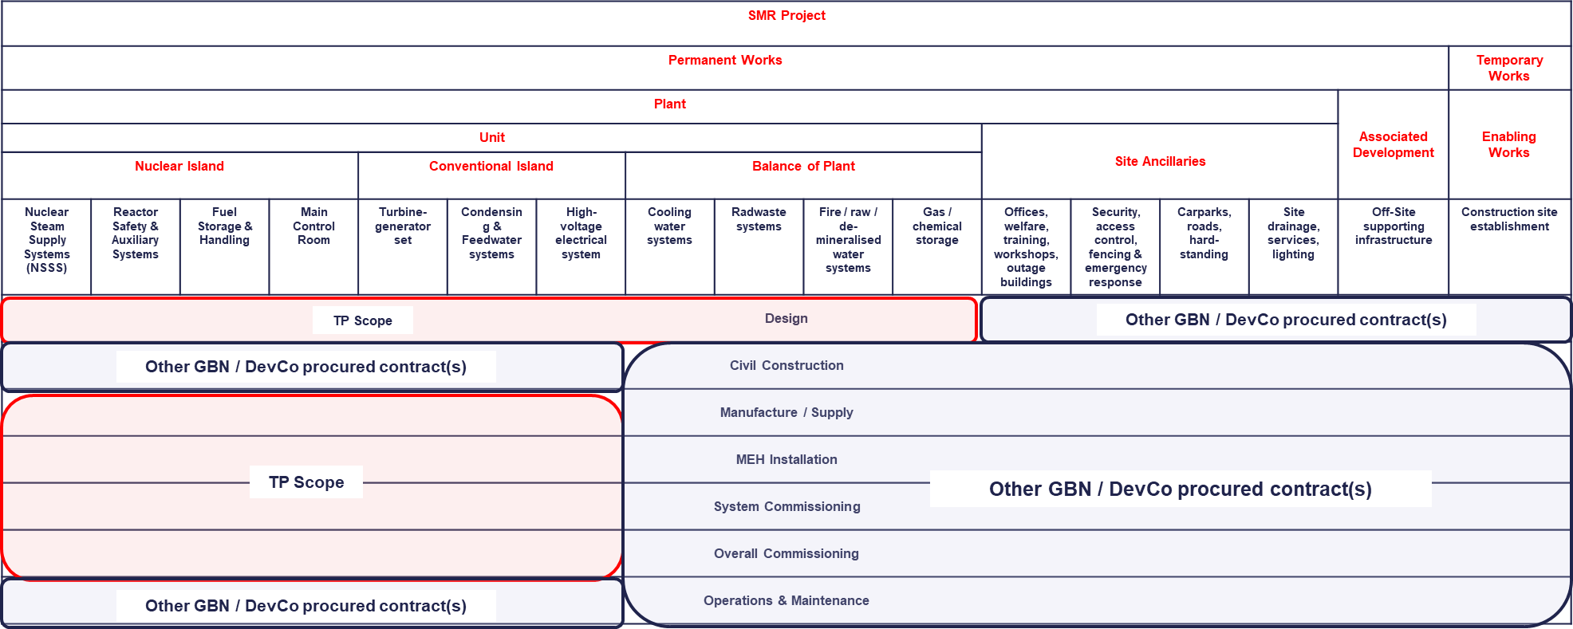
10.1 Overall SMR project scope
This slide is intended to provide an overview of the scope GBN has identified to be delivered.
This overview should act as guidance to participants regarding the spread of scope under the SMR Project.
TP scope will be provided by one Technology Partner (per SMR project), all other scope will be provided by multiple suppliers (to be appointed).

