Slide 1
Appendix G Structure and Architecture

Slide 2
Who are we and what do we do?
The Mining Remediation Authority was formed to manage the legacy of coal mining after the privatisation of the coal industry.
We are governed by the Coal Industry Act 1994 and sponsored by the Department for Energy Security and Net Zero.
Our mission: Making a better future for people and the environment in mining areas.
Our purpose:
We keep people safe and provide peace of mind
We protect and enhance the environment
We use our information and expertise to help people make informed decisions
We create value and minimise cost to the taxpayer
We use our skills to provide services to other government departments and agencies, local governments and commercial partners
We are a 24/7 Category 2 emergency response organisation, responding to public safety and subsidence incidents caused by historical coal mining

Slide 4
Our statutory duties
Our Digital services ensure that we meet our statutory obligations regarding:
maintenance and availability of our legacy coal mining data
a public safety and subsidence remit
support to the planning system
obligations as a Category 2 responder for local and national emergencies
These are detailed in the following legislation:
The Coal Industry Act 1994
The Civil Contingencies Act 2004 (Amendment of list of responders) Order 2023
Schedule 4 and Article 26 of the Town and Country Planning (Development Management Procedure) (England) Order 2015

Slide 5
Organisational chart
Head of Digital
Service and Governance
Business Analysis
Operational Delivery and Development
Information Security and Assurance
Digital Contracts and Spend Management
User Research
Business Analysis
Cloud Infrastructure Azure and Wintel
Database
Delivery Management
Service Management
Development and Support
Cloud Infrastructure AWS
Programme Management
Service Desk
Desktop Support

Slide 6
Team capability – Management
Function | Team Composition | No. | Anticipated Contract Scope / Interaction
Head of Digital | Head of Digital | 1 | Responsible for delivery of Digital Services
Programme Mgmt. | Digital Programme Manager Digital Programme Coordinator | 2 | Coordinates forward looking Digital programme with contractors programme/ project management team.
Delivery Mgmt. | Delivery Manager | 1 | Works with suppliers Delivery / Project Managers to agree delivery approach (agile, waterfall, hybrid) and deliver agreed work coordinating internal and external resources.
Technical Architect | Technical Architect | 1 | Technical Architect will work the internal team and suppliers specialists to agree approach, best practice and standards with regards to technical architecture.
Background pic of Gerry with headset on?

Slide 7
Service and Assurance
Head of Digital
Principal Service and Governance
Programme Manager
Lead Service Manager
Testing and Quality Assurance Lead
Information Security Manager and Assurance Lead
Delivery Manager
Support Manager
Digital Contracts and Spend Manager
Digital Programme Coordinator
Service Manager
Service Coordinator
Lead QA Specialist
Information Security Analyst
Service Desk Analyst
QA Specialist
Service Desk Analyst

Slide 8
Team capability – Service & Assurance
Function | Team Composition | No. | Anticipated Contract Scope / Interaction
Principal Service & Governance | Principal | 1 | Principal manager responsible for assuring services meet the requirements of the agreed business SLA’s, OLA’s, KPI’s.
Service Management | Lead Service Manager Service Manager Service Coordinator | 3 | Work with suppliers to ensure services meet required SLA’s, OLA’s and KPI’s responsible for ensuring work meets required acceptance criteria when promoted to live
Service Desk | Support Manager Service Desk Analyst x2 | 3 | Provide 1st line support, incident and change management logging and support
Test and QA | Testing and Quality Assurance Lead Lead QA Specialist QA Specialist | 3 | Will work with the supplier to develop appropriate test regimes and undertake execution of application testing. Provide expert domain knowledge.
Information Security | Information Security Manager & Assurance Lead Information Security Analyst | 2 | Provide information security policy development and compliance, posture and risk assessments against industry best practice and standards.
Digital Contract & Spend Manager | Digital Contract & Spend Manager | 1 | Supplier facing role managing contract performance and Cabinet Office spend control assurance.
Background pic of Gerry with headset on?

Slide 9
Operational Delivery & Development
Head of Digital
Principal Operational Delivery
Lead Cloud Infrastructure Engineer
Cloud (Azure) Wintel Lead
Support Manager
Database (Cloud) and Desktop Lead
Technical Lead (Development)
Cloud Infrastructure Engineer
Junior Cloud Engineer
System Administrator
System Administrator
Desktop Support Technician
Desktop Support Technician
Senior Developer (Java)
Design and Web Manager
Desktop Support Technician
Senior Developer
Digital and Design Officer
ICT Developer
Graphic Designer

Slide 10
Team capability – Operational Delivery & Development
Function | Team Composition | No. | Anticipated Contract Scope/Interaction
Principal – Operational Delivery | Principal – Operational Delivery | 1 | Principal manager responsible for technical services ensuring that they meet the requirements of the agreed business SLA’s, OLA’s, KPI’s.
Database | DBA / Cloud Engineer | 1 | Provide database expertise i.e. Postgres / SQLServer to provide operational resilience and project support. Flex up for project and data migration activities.
Desktop Support | Desktop Support Technician | 3 | Responsible for managing End User Device estate and supported software incident, change and patching.
Cloud and Infrastructure AWS & Linux | Lead Cloud Infrastructure Engineer Cloud Infrastructure Engineer Junior Cloud Engineer | 3 | Responsible for development, maintenance and enhancement of AWS and Linux Infrastructure estate.
Cloud and Infrastructure Azure & Wintel | Cloud Azure Wintel Lead Systems administrator x2 | 3 | Responsible for development, maintenance and enhancement of Azure, Microsoft Infrastructure estate and SaaS application integration and support.
Background pic of Gerry with headset on?

Slide 11
Team capability – Operational Delivery & Development
Function | Team Composition | No. | Anticipated Contract Scope / Interaction
Technical Lead | Technical Lead Development | 1 | Development Technical Lead, works with supplier to develop and agree development standards. Ensures compliance
Internal Development Team (Hybrid development team internal) | Senior Developer x2 ICT Developer | 3 | Currently provide support and development. Primarily Java(EE) development, some Power Platform, Plexus (BancTec) Considering separate support element for incident and unplanned small change. Development team support planned change and project pipeline. Requirement to flex capacity. Support / Development team design and composition under consideration
External Development Team (Hybrid development team) | Senior Developer x3 Developer x2 | 5 | As above
Graphic Design and Web Management | Design and Web Manager Graphic Designer x2 | 3 | Responsible for all web content / website development and corporate intranet. Undertake accessibility reviews / outline best practice and compliance. Provide graphic design services
Background pic of Gerry with headset on?

Slide 12
Business Analysis
Data and Information
Head of Digital
Head of Information
Principal Data and Information
Principal Business analyst
Digital Operating Model Advisor
GIS Lead and Architect
Data Innovation Manager
Senior Business Analyst
Senior Business Analyst
Senior User Researcher
Senior GIS Developer
Data Innovation Manager
Junior Business Analyst
Business Analyst
Business Analyst
Geospatial Engineer
Data Innovation Manager

Slide 13
Team capability – Business Analysis
Function | Team Composition | No. | Anticipated Contract Scope / Interaction
Principal – Business Analyst | Principal – Operational Delivery | 1 | Principal manager responsible for business analysis services ensuring that they meet the organisational requirements to agreed best practice
Business Analysts | Senior Business Analysts x2 Business Analysts x2 Junior Business Analyst | 5 | Provide business analysis services
User Needs Researcher | Senior User Researcher | 1 | Provides user research analysis and insights
Background pic of Gerry with headset on?

Slide 14
Team capability – Data & Information
Function | Team Composition | No. | Anticipated Contract Scope / Interaction
Head of Information | Head of Information | 1 | Head of Mining information responsible the development and maintenance of the UK mining database
Principal Data & Information | Principal – Data & Information | 1 | Principal manager responsible for data and information ensuring that they meet the organisational requirements to agreed standards
GIS Lead & Architect & Developers | GIS Lead & Architect Senior GIS Developer Geospatial Engineer | 3 | Lead GIS Developer, will work the supplier geo-spatial specialists to agree approach, best practice and standards. Geospatial developers
Background pic of Gerry with headset on?

Slide 15
Our architecture

Slide 16
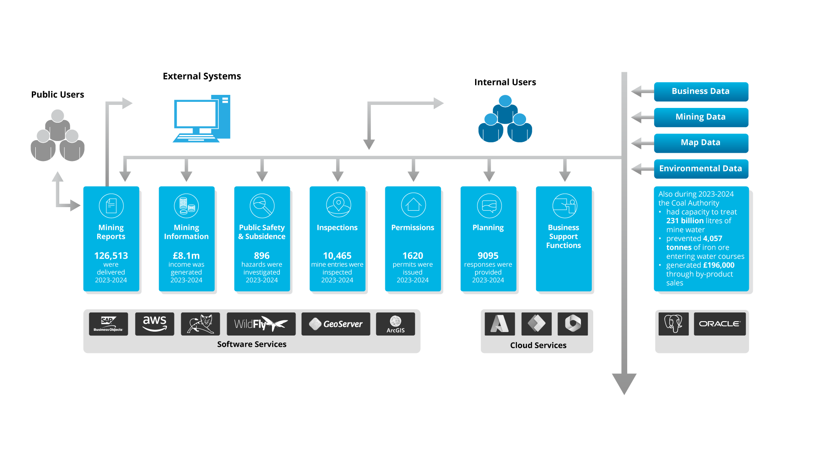
Services

