Slide 1
Holloway Park Project Background

Slide 2

Holloway Park
Preamble
Purpose: This document is intended to provide additional background information for the purposes of project understanding.
Note: Whilst we have made an effort to provide information in a user-friendly format which will be of use for aiding project understanding, it should be noted that information and images in this presentation are subject to change for through continued design development (for phase 1) in addition to the redesign of phases 2 and 3 ahead of a revised planning application. Information in this presentation should therefore be considered indicative.
More up to date and detailed design information can be found in the drawings pack provided.

Slide 3
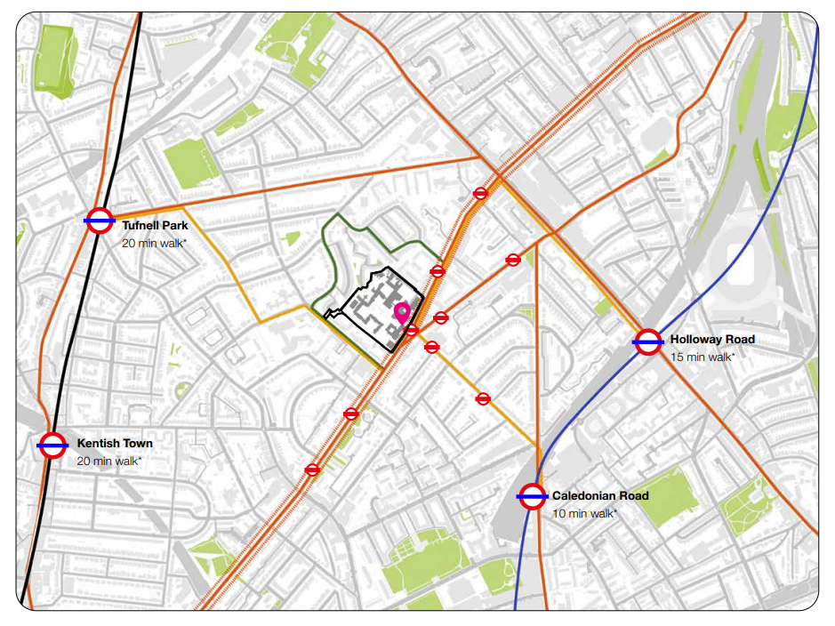
Holloway Park
Location

Slide 4
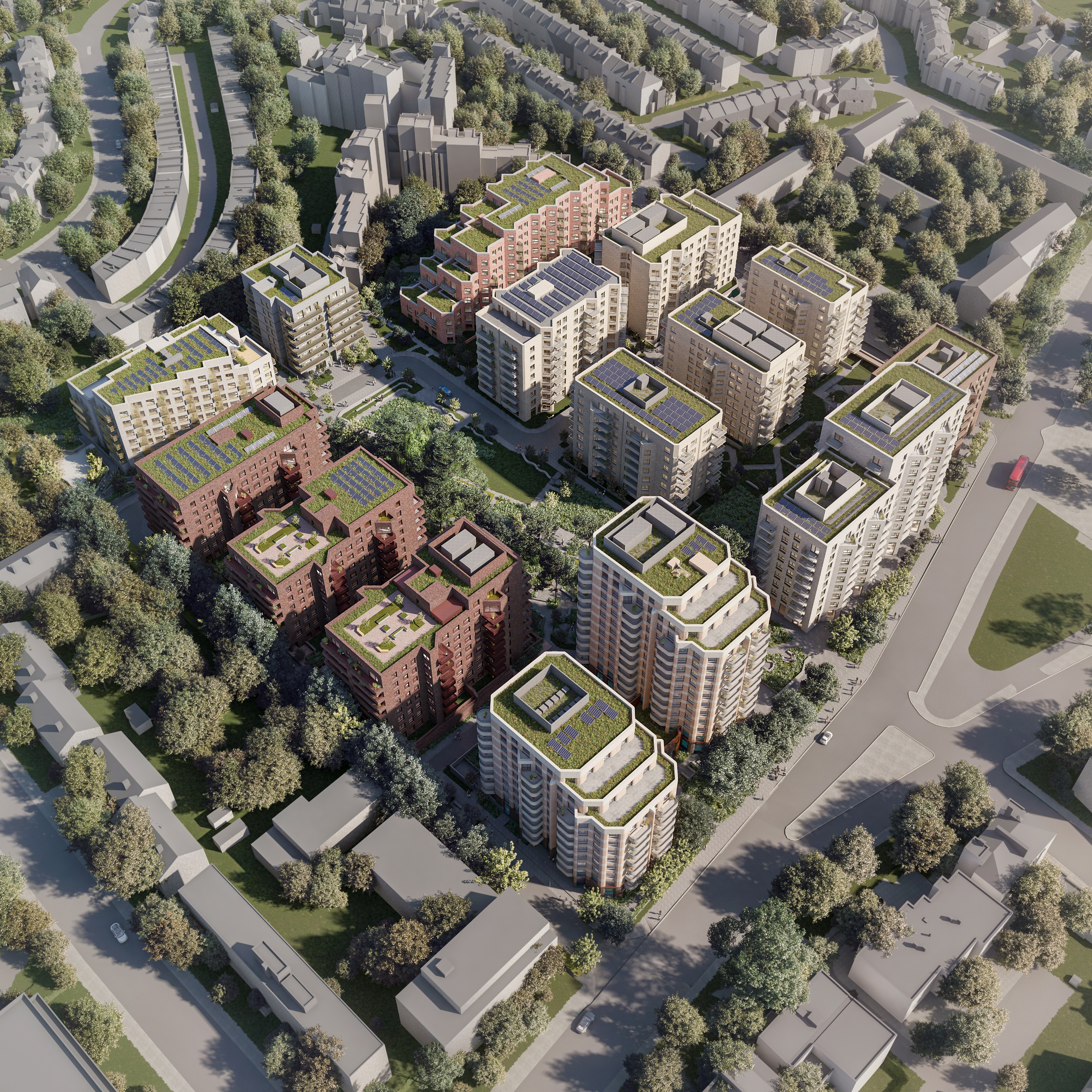
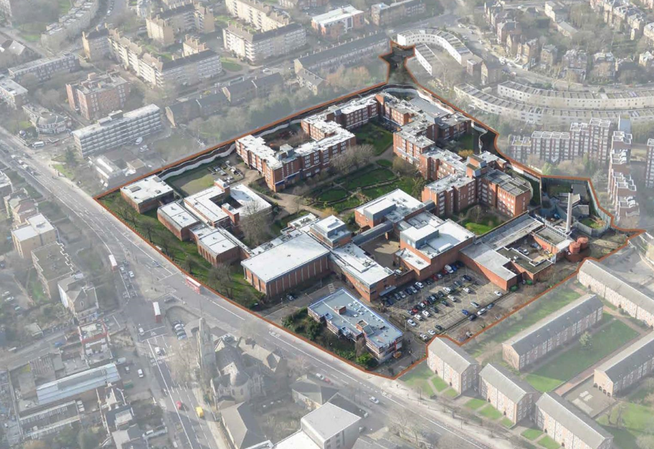
Holloway Park
Consented masterplan
Consented Masterplan: 985 new homes (60% affordable):
415 social rent (42%)
178 shared ownership (18%)
392 private (40%)
NB Phases 2 and 3 are under redesign ahead of a revised planning application to be submitted in late 2025 to deliver a c. 1,100 home masterplan.
Extra Care
Public Park
New Connection
Phase 1: 429 homes - 50% social rent, 8% shared ownership, 46 % Market
Phase 2: 235 homes - 49% social rent, 22% shared ownership, 29 % Market
Commercial Space
Phase 3: 321 homes - 26% Social Homes, 34% shared ownership, 40% Market
Commercial Space
Women’s Building
Residents’ Facilities & Concierge

Slide 5
Holloway Park
Consented masterplan - schedule of accommodation
Residential Schedule of Accommodation – Consented Masterplan
 | 1B2P | 2B4P | 2B3P | 3B4P | 3B5P | 4B5P | 4B6P | 4B7P | Total
Market | 87 | 254 | 24 | - | 27 | - | - | - | 392
London Shared Ownership | 96 | 75 | 7 | - | - | - | - | - | 178
Social Rent | 106 | 160 | 55 | 20 | 61 | - | 10 | 3 | 415
Total | 289 | 489 | 86 | 20 | 88 | - | 10 | 3 | 985
NB this is for all phases of the 985 homes consented masterplan – phases 2/3 are under redesign to deliver circa 1,100 homes ahead of a revised planning application.
Non-Residential – Consented Masterplan
 | NIA (sqm) | GIA (sqm) | GEA (sqm)
Residents’ Facilities | 1,152 | 1,334 | 1,412
Commercial | 1,244 | 1,760 | 1,931
Women Building | 1,458 | 1,490 | 1,573
Total | 3,854 | 4,584 | 4,916

Slide 6
Holloway Park
Phase 1 - schedule of accommodation
Residential Schedule of Accommodation – Phase 1
 | 1B2P | 2B4P | 2B3P | 3B4P | 3B5P | 4B5P | 4B6P | 4B7P | Total
Market | 18 | 146 | 8 | - | 24 | - | - | - | 196
London Shared Ownership | 5 | 12 | 1 | - | - | - | - | - | 18
Social Rent | 93 | 39 | 42 | 19 | 21 | - | 1 | - | 215
Total | 116 | 197 | 51 | 19 | 45 | - | 3 | - | 429
Non-Residential – Consented Masterplan
 | NIA (sqm) | GIA (sqm) | GEA (sqm)
Residents’ Facilities | 1,152 | 1,334 | 1,412
Commercial | 92 | 93 | 112
Women Building | 1,458 | 1,490 | 1,573
Total | 2,702 | 2,917 | 3,097

Slide 7
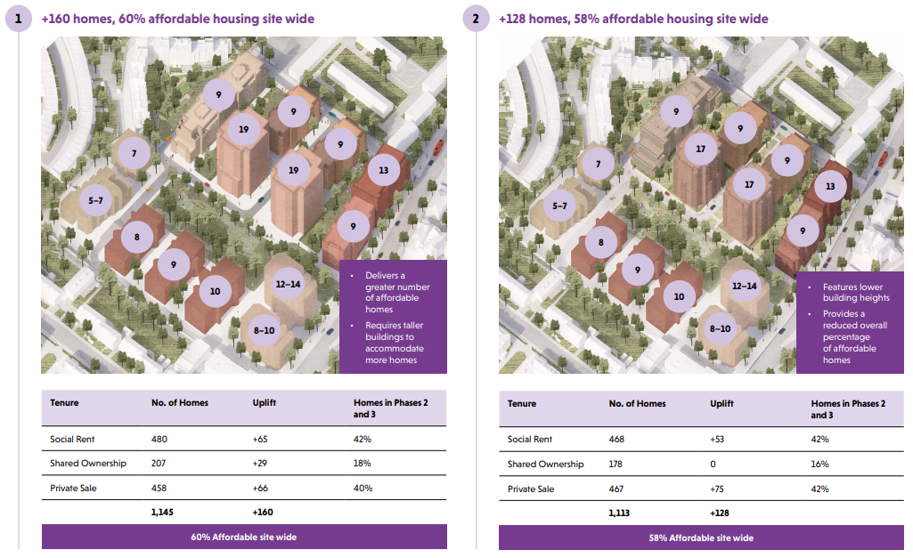
Holloway Park
Phases 2/3 – indicative revised unit uplift
Phase 2/3 Redesign
In response to changes in building regulations and market conditions, we are reconfiguring the design of buildings and layout of spaces in Phases 2 and 3 to sensitively increase the number of homes.
We are currently exploring an uplift of 128 to 160 additional homes, while maintaining a strong focus on high-quality design, affordability, and maximising green spaces.
The revise proposals under consideration are shown to the right and are subject to ongoing design development.

Slide 8
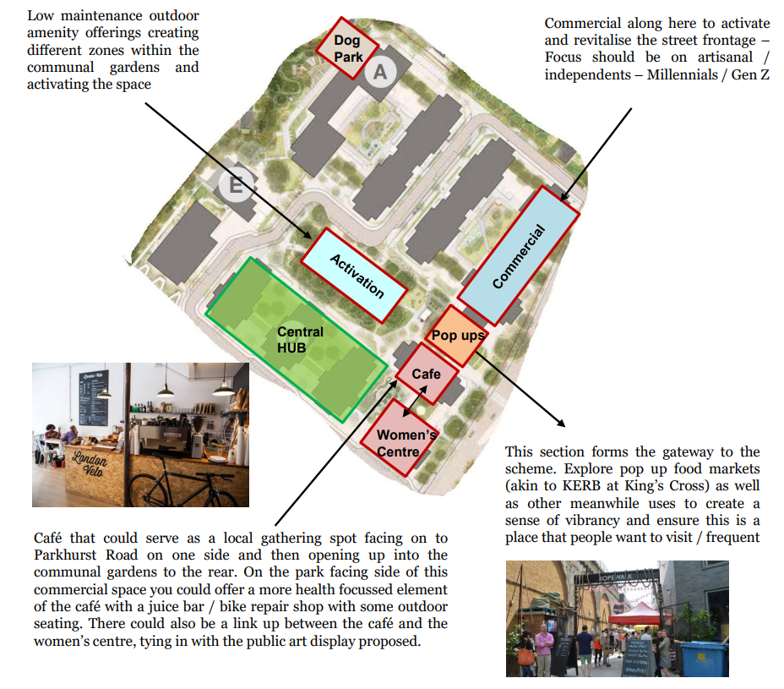
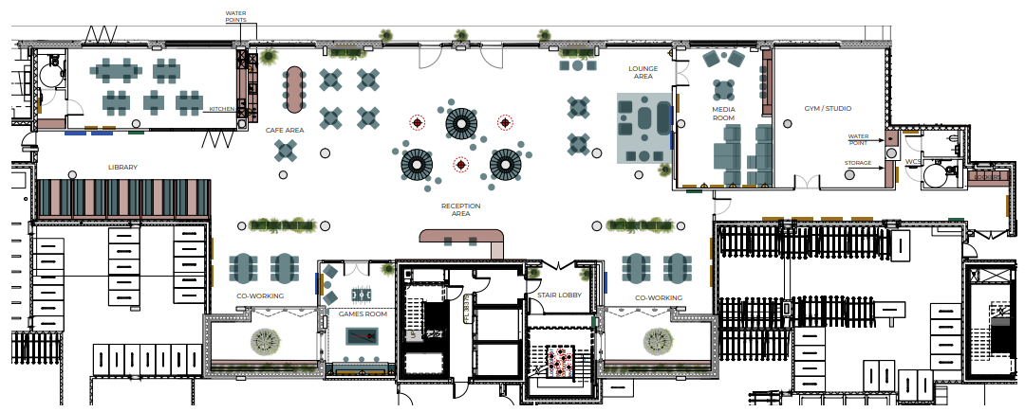
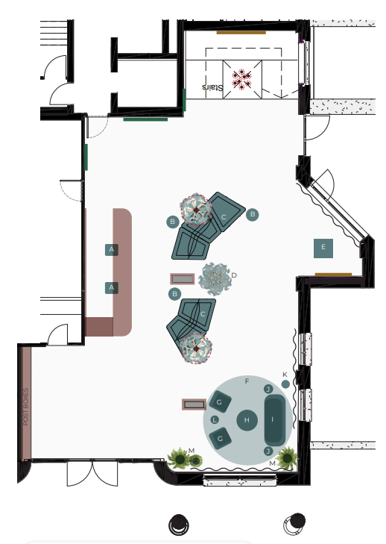
Holloway Park
Residents’ Facilities (indicative)
Residents’ Facilities – Lower Ground Floor (UNDER REVIEW)
Residents’ Concierge – Upper Ground floor
Resident Facilities include:
Gym
Cinema/media room
Games Room
Lounge Area
Workspaces
Co-working space
Meeting/podcasting booths
Bookable dining space
Self-serve coffee
Reception (Lower Ground)
Concierge (Upper Ground)
Service Charge for the Residents’ Facilities
The residents’ facilities design is under review so may be subject to change; however, the principal facilities are listed above. Facilities will be available to all residents of the development, irrespective of tenure. Peabody is mindful of service charge affordability, particularly for the residents of the affordable tenures. Therefore, the social rent and shared ownership residents will be given the opportunity to opt-in/opt-out for access to these facilities, and therefore only pay service charge for these facilities if they have chosen to access them. Private leaseholders will automatically opt-in for these facilities and will have no opportunity to opt-out.

Slide 9
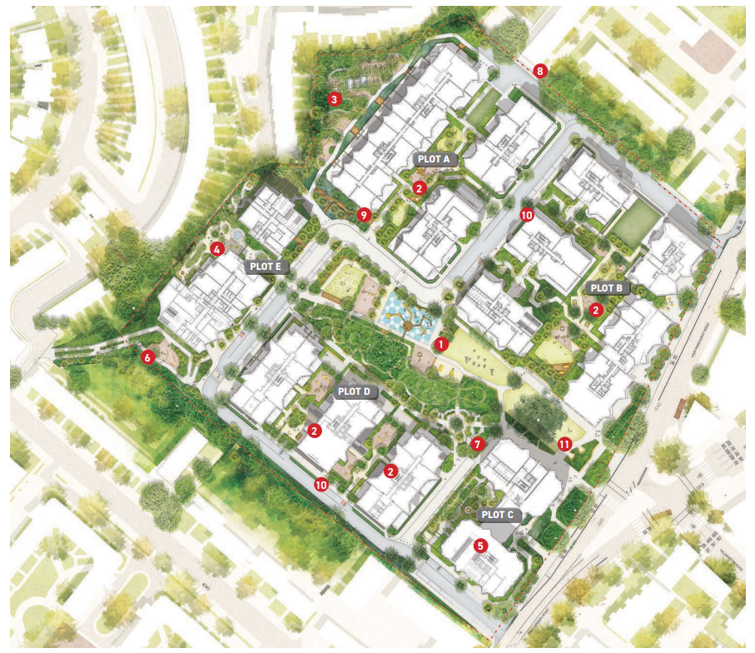
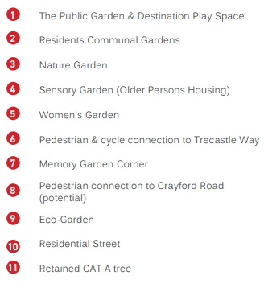
Holloway Park
Landscaping – Consented Masterplan

Slide 10
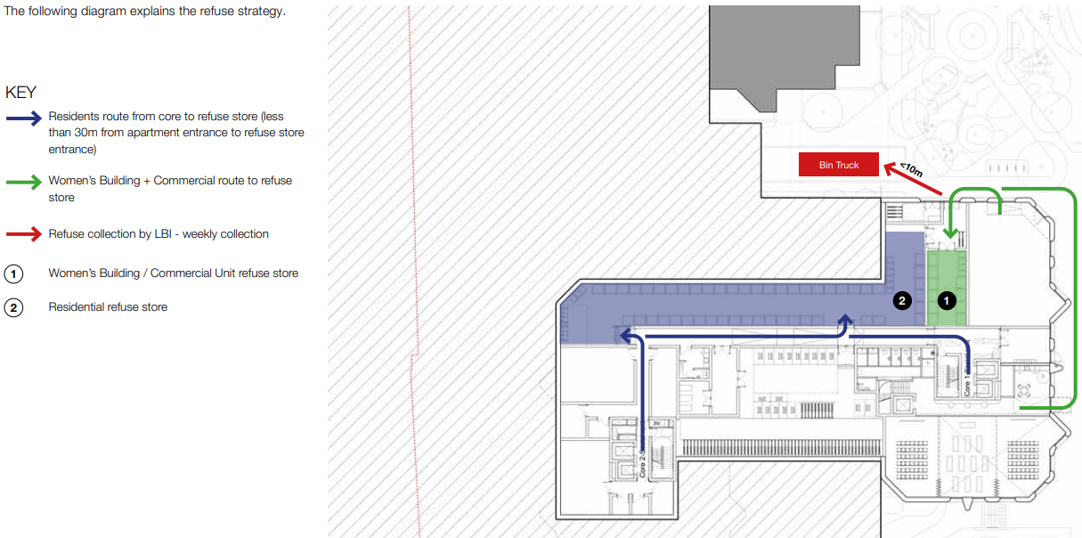
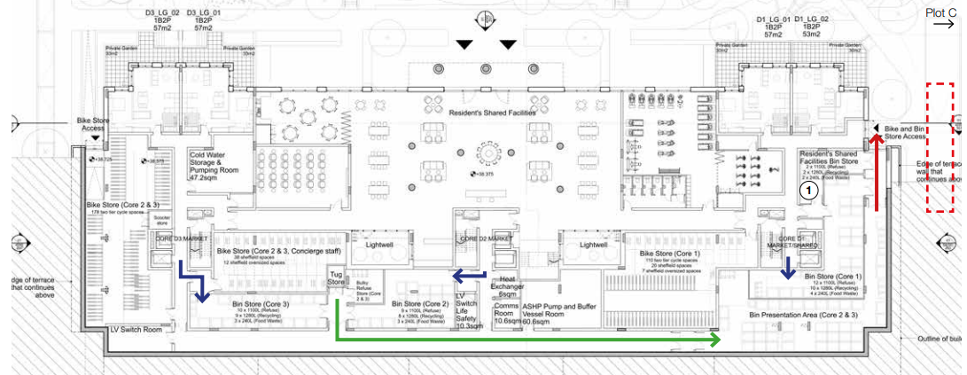
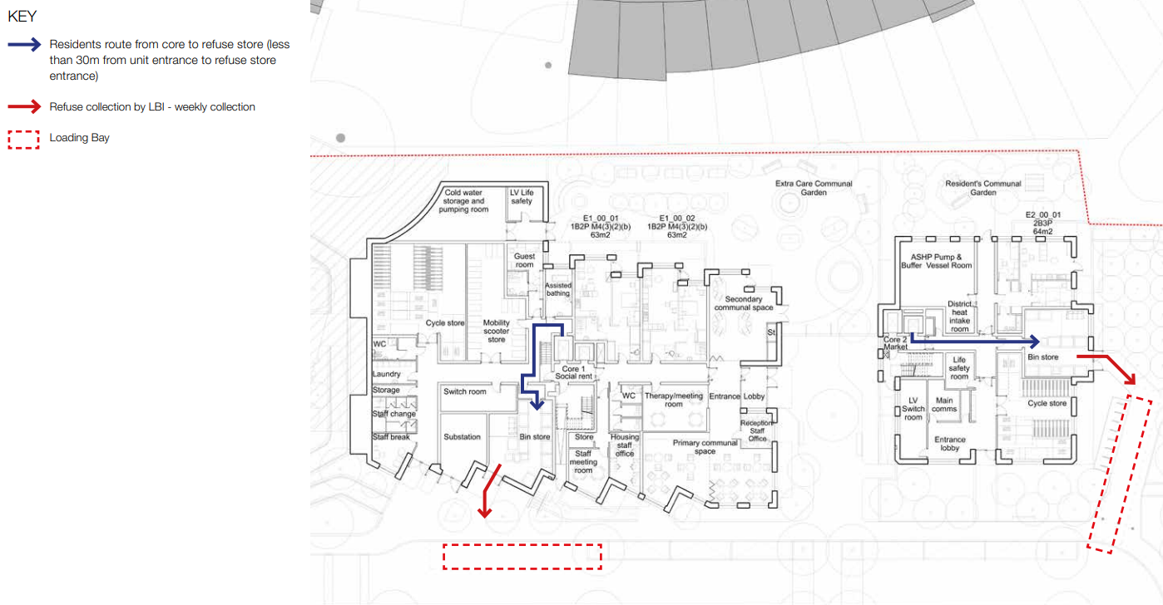
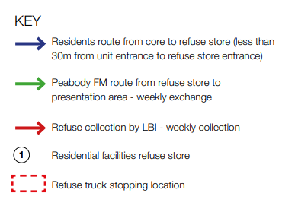
Holloway Park
Servicing and refuse
Phase 1
Plot C – Refuse stores located in lower ground floor.
Plot D - Refuse stores located in the partly submerged lower ground floor. Each core is provided with its own refuse store. On collection day, an on-site facilities management team will bring the bins to a holding areas and be on hand for refuse collection from the street between C and D.
Plot E – Refuse store located on GF for each building.
Plot C
Plot D
Plot E

Slide 11
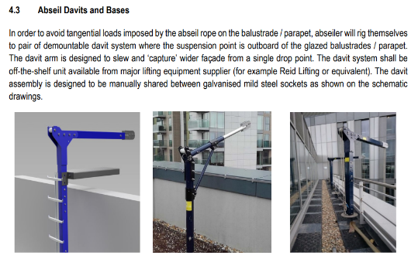
Holloway Park
Window cleaning strategy
Window cleaning and light facade maintenance will be necessary to all external elevations. This will involve managed solutions and to achieve 100% coverage, this will involve some use of access equipment.
The broad strategy is for:
Windows on the lower storeys to be cleaned from the ground using a Reach and Wash pole.
Windows on the upper storeys to be cleaned via an abseil system.
Residents to clean windows directly from balconies where possible (except the extra care building, which will require a managed solution).
Please refer tot the façade access and maintenance strategy for more detail.

Slide 12
Holloway Park
MEP
Heating systems
Heating to all plots will be provided by LTHW generated by roof mounted ASHPs. During 5% of the year, on average, when the ambient temperature is too cold to achieve flow temperature of 55%, electric boilers will be brought online to ensure the required flow temperature. Currently for phase 1 two electric boilers are required to be located with the ASHP plantroom.
Each apartment will be provided with an HIU and will be primarily heated using a ‘wet’ underfloor heating (UFH) system.
A capped LTHW supply will be provided for the commercial units as part of the shell and core package.
Water
Mains water will be bought to site from a connection to the water utility main in Parkhurst Road.
Cold water will be distributed throughout each building. From the riser, pipework will be distributed through the corridor on the floor, with individual branches off to the utility cupboard of each apartment.
Each apartment water utility meter will be located in the riser.
Sprinkler system in each apartment.
Commercial spaces, resident amenity spaces will be provided with sprinkler systems.
Gas
A low-pressure gas supply will be brought into the site for the benefit of the commercial spaces. The supply will be taken to plot B’s dedicated lower ground floor meter room and also to a capped off connection outside of plot C’s commercial unit
Electrical:
PV panels will be located at roof level. The electricity generated will only be used for landlord services, such as lighting, lifts and pumps.
Apartments will have MVHR units + cooling module.
EV charging points to all 30 wheelchair parking spaces.
Each plot will be served via its own single or twin substation, which shall provide metered LV electrical supplies for the landlord, residential and commercial areas.
Each apartment will be provided with a fused multi distribution panel.
General and emergency lighting provided within communal lobbies.
External lighting will be designed in accordance with the requirements of the landscape architect.
Lifts
Lifts are provided in each block.
A firefighting lift will serve each building.
A total of 16 lifts are being provided in phase
Security
Access to the buildings will be via and electronic access control system
CCTV cameras to be installed for vehicle parking, cycle sores., entrance lobbies and public realm.
Fire
All flats will be provided with a standalone fire alarm system.
All landlord areas will be provided with an automatic fire alarm system.
A primary fire alarm panel will be located in the entrance of each block.
Lighting protection
A full lighting protection system will be provided to all buildings.
Drainage
Rainwater will be conveyed from the roof areas and balconies to below ground drainage through external rainwater pipes.
A landlord stack will be located within the cores of each building for foul drainage.

Slide 13
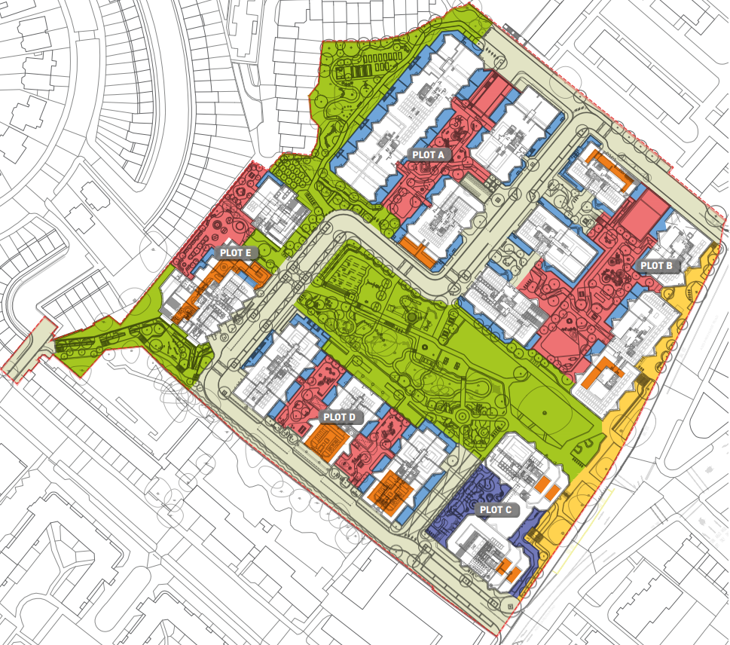
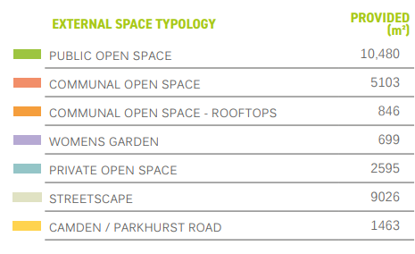
Holloway Park
Landscaping
The development provides a large amount of publicly accessible space. The public garden and nature garden, along with the new connection to Trecastle Way makes up a large proportion of the public realm.
The Managing Agent will be responsible to the management of the public realm, including the service road. None of the spaces will be adopted by the Local Authority.
All plots include an area of communal open space which will need to be maintained by the Managing Agent, with the exception of the Women’s Building garden, which will be maintained by the tenant of the Women’s Building.
Management and maintenance of the public realm and landscape is vital in ensuring that the proposed development contributes positively to the visual elements of the area and creates usable and valued spaced for the residents and visitors to enjoy.

Slide 14
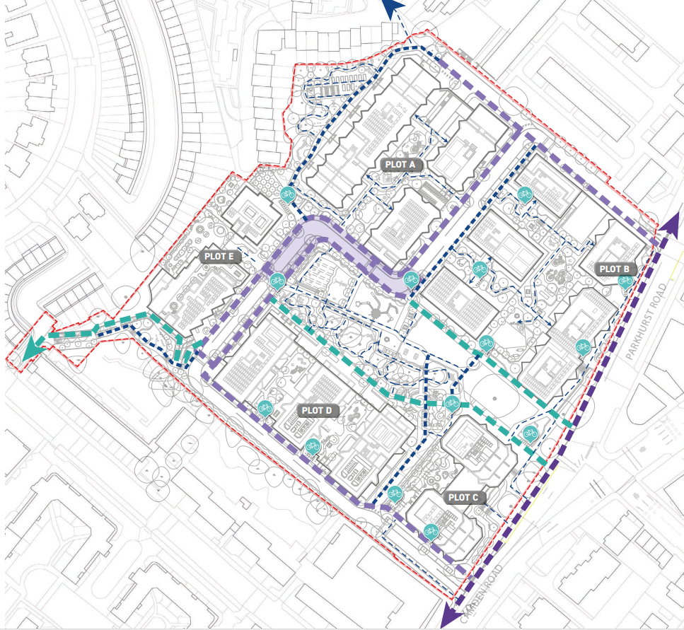
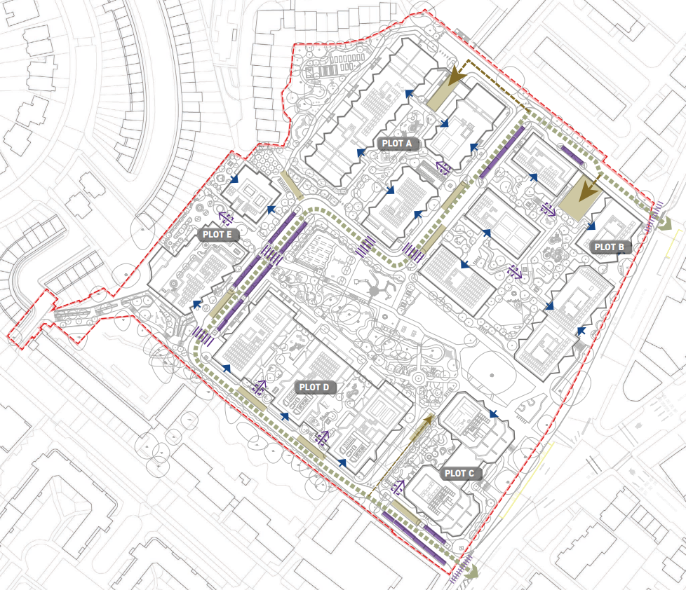
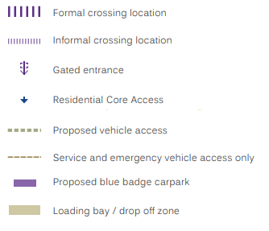
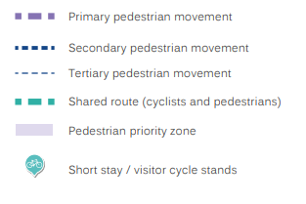
Holloway Park
Landscaping strategies
A variety of movement networks are proposed across the site which favour pedestrians and cyclists (NB phases 2/3 subject to redesign).
A new service road will be provided through the site, along with 30 resident wheelchair parking bays and loading/drop off zones.

Slide 15
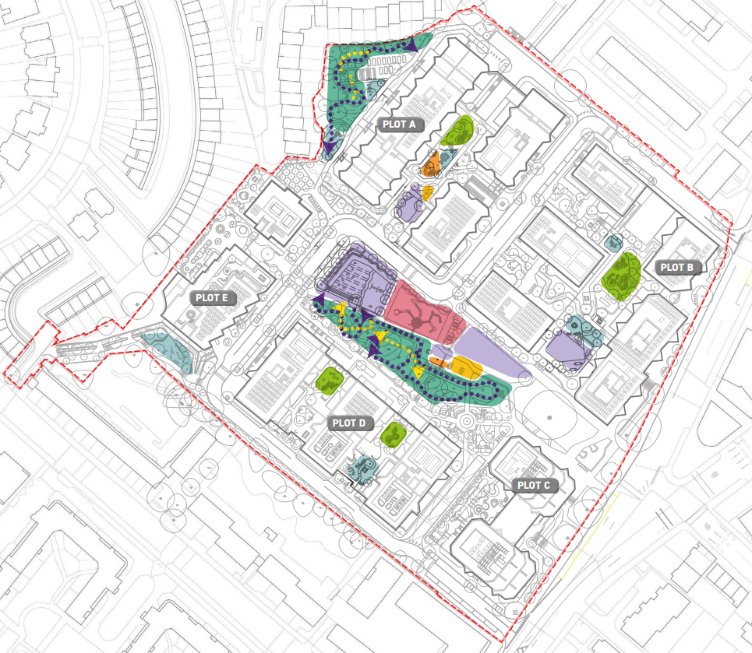
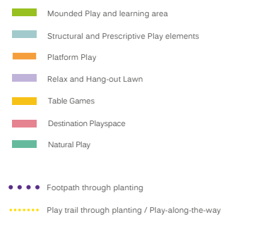
Holloway Park
Play space (indicative)
A variety areas of play space will be provided (approximately 5,300m2).
Within the Public Garden the play offering includes provision for traditional play areas / features, lawn areas for non-prescriptive play, and natural trails through planting and under tree canopies.
A destination play spaces with a play tower, swings, climbing nets and slide is proposed.
The proposals include natural play features such as logs, steps and boulders along with more structured elements such as timber structures, animals and mounding. Areas of lawn will provide additional informal play space. Seating will be provided in close proximity to play.

Slide 16
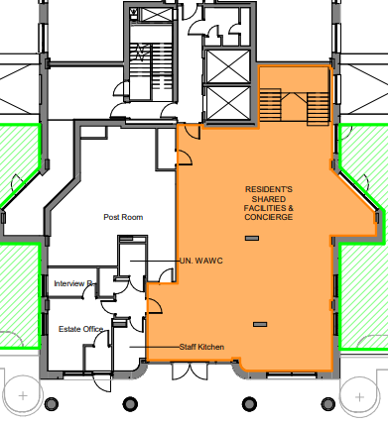
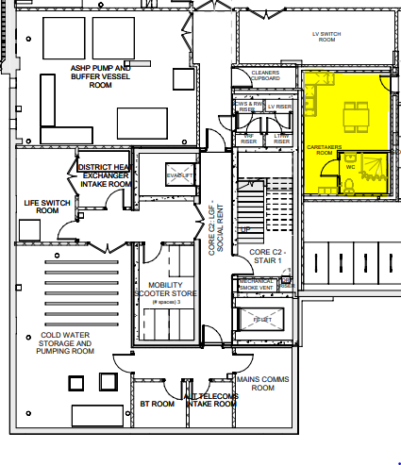
Holloway Park
Caretaking/estate office
A caretakers' welfare facility is located in Plot C for use by the estate team.
Separate welfare facilities are located adjacent to the concierge in plot D. This is for use by the concierge and Peabody neighbourhood management team.
An estate office is also located in Plot D adjacent to the concierge. This is for sole use by Peabody’s neighbourhood management team.
Caretakers’ Welfare Facilities (Lower Ground Floor)
Concierge + Estate Office (Upper Ground Floor)

Slide 17
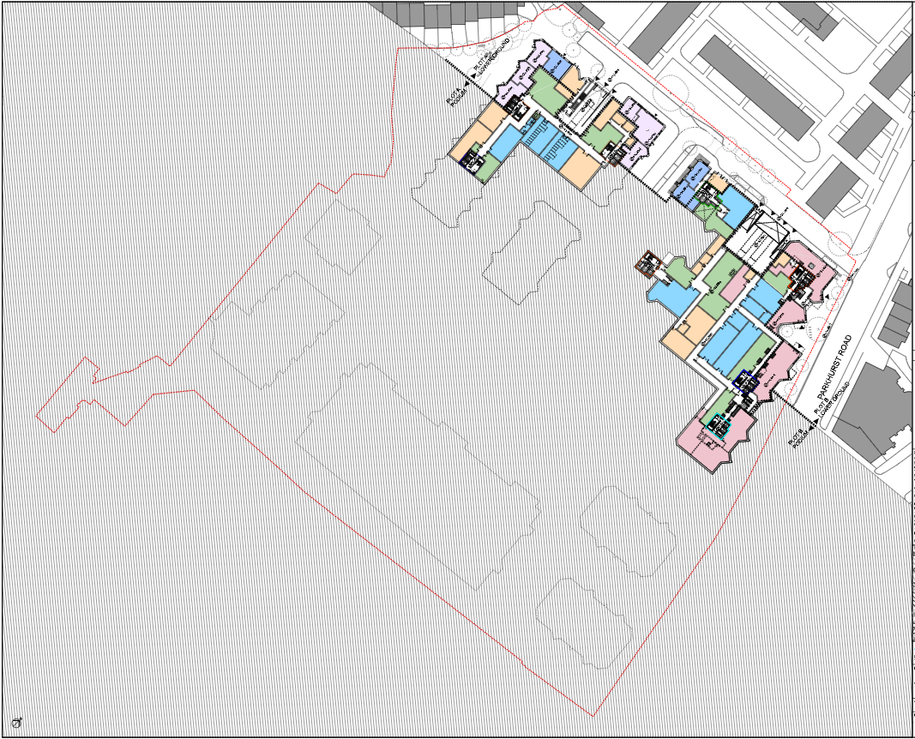
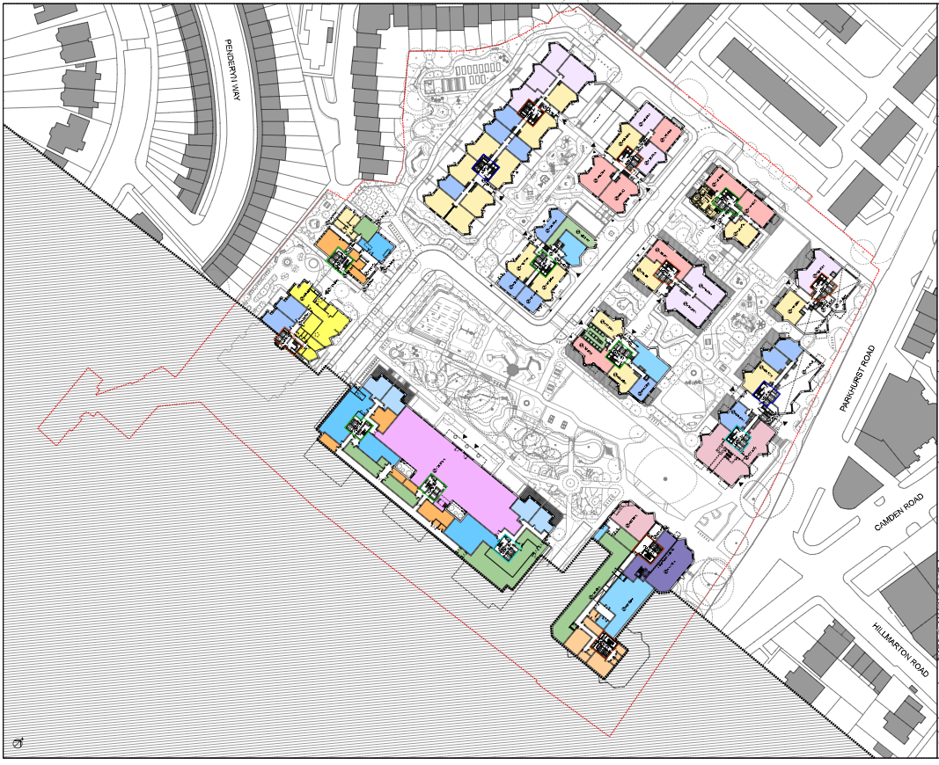
Holloway Park
Commercial (consented scheme)
Holloway Park will provide c.1,800 sqm GIA of commercial space (subject to change with ph 2/3 redesign), with indicative uses shown below. The majority of the commercial space will be delivered in ph2/3.
The commercial spaces will be let on internal repair and insuring leases.
The commercial tenants will be responsible for their refuse strategy.
Phase 1 Plot C – 92 sq m NIA, 112 sq m GIA
Café/Coffee Shop
Wellness studio
Phases 2/3
Express supermarket
Independent stores e.g. hairdresser, florist, bakery etc.

Slide 18
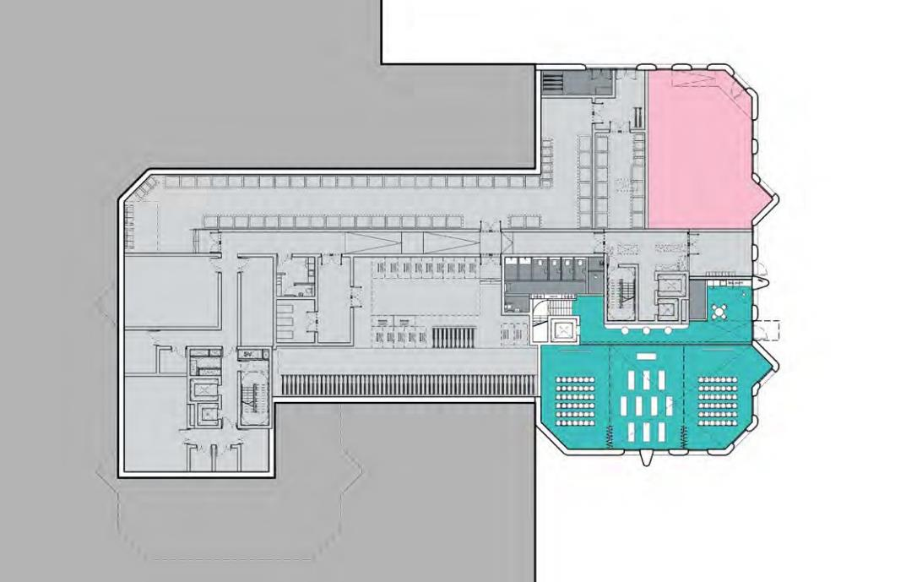
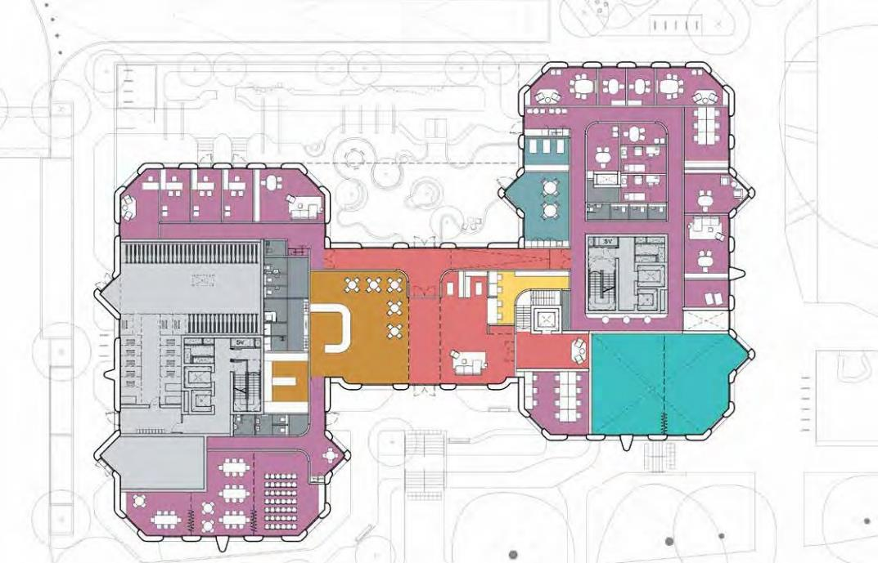
Holloway Park
Women’s Building
Holloway Park will provide a c.1,490 sqm GIA Women’s Building, with a dedicated garden
The Women’s Building will be let on an internal repair and insuring lease
The tenant will be responsible for the maintenance of the garden
The tenant will also be responsible for their refuse strategy
Lower Ground Floor
Upper Ground Floor

Slide 19
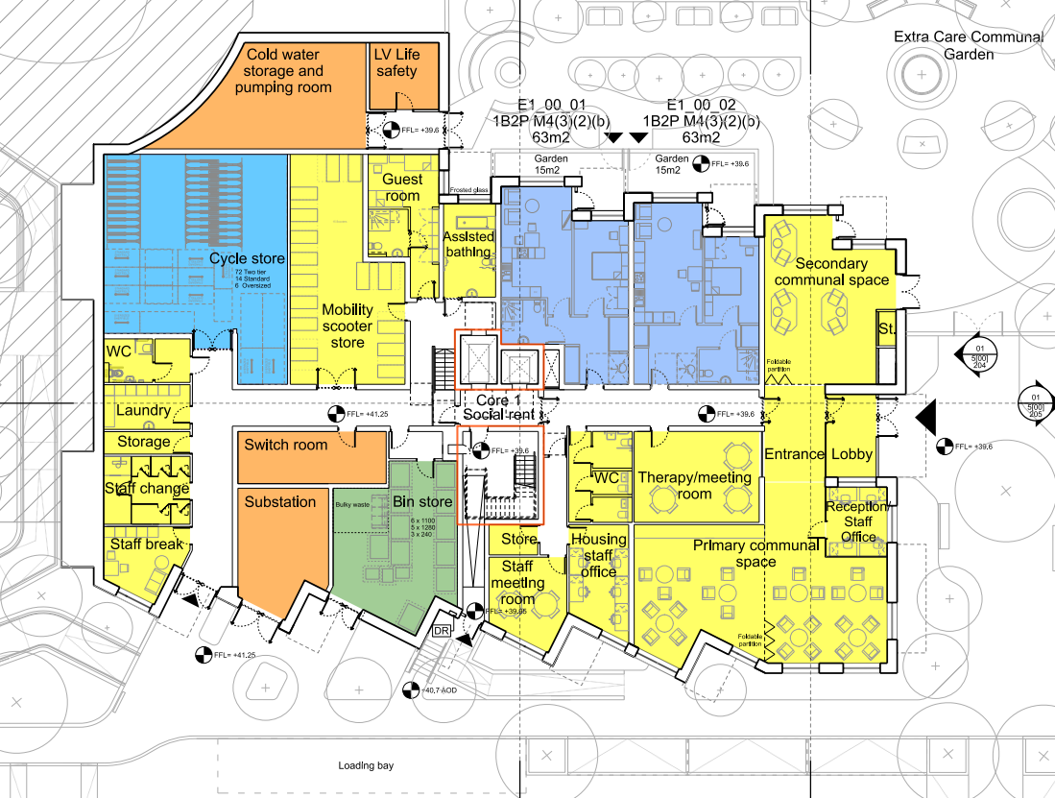
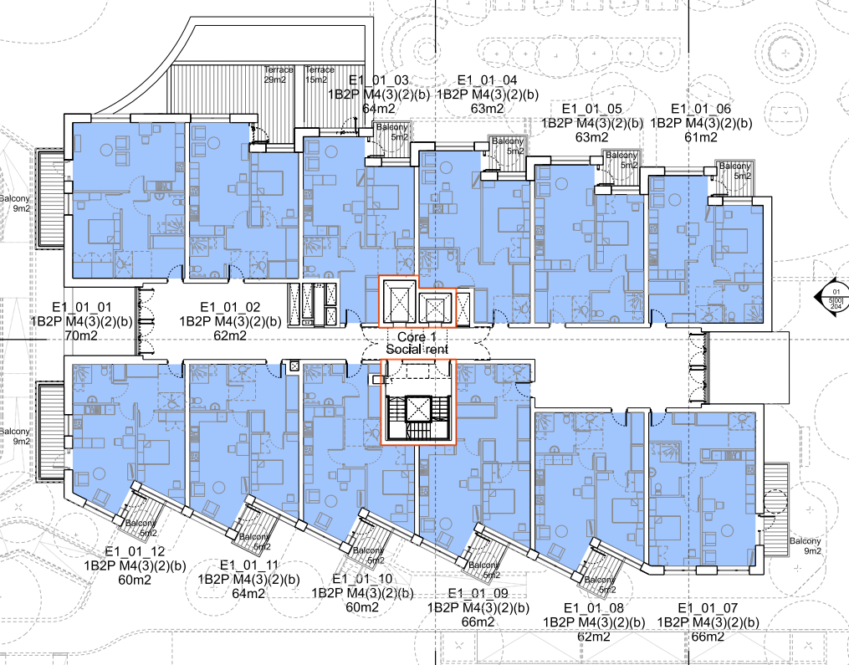
Holloway Park
Extra Care
Holloway Park will provide 60 x 1B2P Social Rent Extra Care homes
The Managing Agent will be responsible for the management and maintenance of this building including internal communal and staff areas.
Care services for these residents will be provided separately through a care provider, and therefore the Managing Agent does not need to make allowances for the care services, however consideration should be given to the client group, and relevant training should be provided to site personnel.
Ground Floor
Upper Floors

