Slide 1




High Risk IDVA Service
July 2025
Presented By: Olivia Wilson

Slide 2
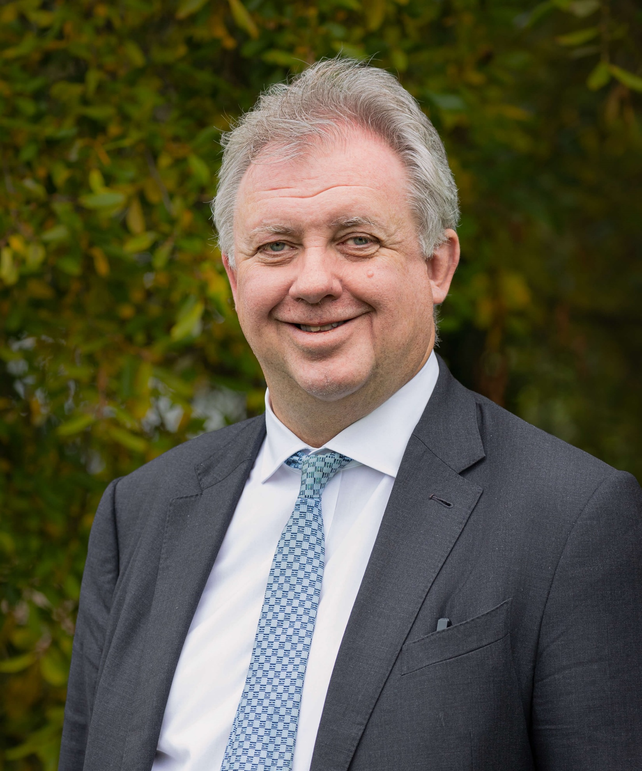

Introduction
Dorset OPCC is launching a process to procure an IDVA service to support high risk victims of DA
@PCCDorset
www.dorset.pcc.police.uk

Slide 3
Background of the Service
2016 - Amalgamation of the IDVA provision with the Police Domestic Abuse Advisor (DAA) service, known as Maple.
DAAs hold dual role, police tasking as well as the role of the IDVA.
2019 - Review of the service – OPCC Led.
2020 - Safelives were brought in to undertake an independent review and make recommendations.
Highlighted the lack of independence and potential loss or non-identification of victims.
Recognition that Dorset is a national outlier.
@PCCDorset
www.dorset.pcc.police.uk
Notes:
2016 – Amalgamation of the external third sector IDVA provision and Dorset Polices DAA Team. The aspiration at the time was for a multifunctional team to deliver both the IDVA role and Police tasking.
2019 – Following concerns being identified by the OPCC in relation to independence of the service and inability to report on service delivery, the OPCC undertook a review into the service which confirmed issues with the lack of independence and inability to meet reporting requirements.
2020 – Safelives brought in to provide an independent assessment of the situation – identifying similar issues.
2021 to Present – Internal review and work delivered to understand which elements are police task and which are IDVA.

Slide 4
The Proposed Service
The new provision will be an IDVA service for high-risk victims of DA
Covering the whole of Dorset.
10 to 12 IDVA Posts
IDVA role will be in line with the Victims and Prisoners Law
@PCCDorset
www.dorset.pcc.police.uk
Notes:
- This is a new provision – In a sense it’s outsourcing, but the Maple Service will remain in Policing in some capacity (yet to be established)
- Geographically – the Service will be Pan-Dorset, covering both Local Authority areas (BCP and Dorset)
- This will mean engagement with different service providers for medium risk services and refuges.
- 10 to 12 IDVA posts in the core contract – There are additional posts funded by the MOJ, but funding currently ceases 31 March 2026 – We will build flexibility into the contract to enable any new posts to be added as and when government offer funding.
- Financially, we’re looking at a potential financial envelope of £600k to £700k per annum.

Slide 5





What’s in Scope
Employment of IDVAs
Community services
Safeguarding and Risk Assessments
Support through criminal justice proceedings
@PCCDorset
www.dorset.pcc.police.uk
Notes:
- The provider would be responsible for the recruitment and management of an IDVA team
- The team would be expected to undertake initial safeguarding, risk assessments, and triage of victims, linking in with other support agencies, as necessary.
- The service will be required to support victims through CJ proceedings to ensure their welfare and reduce the risk of dropping out.

Slide 6






Information Points
TUPE Requirements (TBC)
–
Small number of staff may transfer from existing provision
Physical Offices
–
No expectation for a physical office, but secure space needed to meet clients
MOJ Funding
–
Additional funding for 5 IDVA posts on top of the core contract
Potential Costs
–
£650k Core Budget
£190k MOJ Ringfenced
£90k Pathfinder
@PCCDorset
www.dorset.pcc.police.uk
Notes:
TUPE Requirements TBC – The Service is in effect outsourcing work done by the Police Maple Team. Work is ongoing to establish whether a small number of staff may be eligible for TUPE.
Physical Offices – There will be no formal need to have a physical office space in Dorset, but suppliers will need to be able to facilitate face-to-face meetings with clients in secure space. Suppliers will be offered flexibility as long as the need is meet. Potential for, hiring of office space, co-location with partners.
MOJ Funding – The MOJ has awarded previous rounds of funding for IDVA posts. Subject to funding confirmation from the MOJ, this funding be included in the contract.
MOJ Pathfinder – Specialist DA Court IDVA posts – Separate to the above, ringfenced funding and posts that will support victims going through special DA Courts.
Potential costs – £650k core service contract – Additional £190k MOJ IDVA funding (5 posts) - £90k MOJ Specialist DA Court IDVA(s)

Slide 7

Anticipated Timeline
July-August 2025
Publication of
ITT
November 2025
Tender Closes
& Evaluations
Dec 25
Contract Award
May 26
Contract Commencement
@PCCDorset
www.dorset.pcc.police.uk
Notes:
This is covered off in more detail in the Procurement slide

Slide 8
Strategic Vision
Co-commissioned DA Service
Partners have a desire to co-design and commission local DA services.
Single all risk service, or a single front door
Aligning contracts timelines
Expectation of any incoming provider to support this process
@PCCDorset
www.dorset.pcc.police.uk
Notes:
- The Dorset DA Partnership have been working together for a number of years to explore opportunities to collaborate and co-design services.
- This has led to a local strategic vision to work together towards a co-designed and co-commission DA victim services across Dorset and feel a gold standard service would either be a single ‘all risk’ service, or a single front door for victims who will be seamlessly referred to the relevant agency and subsequently between agencies with minimal disruption.
- To achieve this, we have aligned contractual timeline for our new contracts and over the next contractual term we will continue to work together, with our commissioned providers, to ready ourselves for this opportunity.
- Therefore, any incoming provider would be expected to work with the partnership, taking relevant steps towards achieving this.

Slide 9
Additional Funding
MOJ IDVA Fund - £190k
5 IDVA posts above core contract
Annual award
MOJ Pathfinder - £90k
1 or 2 posts to support special DA courts
To support victims in specialist DA courts only
2 of which are CYP IDVA
@PCCDorset
www.dorset.pcc.police.uk
Notes:
MOJ IDVA Funding
Specific funding for 5 IDVA roles – 2 of which are Children and Young Person IDVAs
Conditions and reporting requirements aligned to the core contract
Comes with an ‘in principle’ multi-year agreement, but formal award is annual – so will be written into the contract as such.
MOJ Pathfinder
The pathfinder project relates to specialist DA courts – Whereas the MOJ have co-ordinated additional fast-track courts for victims going through family court. Due to the speed of this process, the MOJ recognised the need for victims to be supported and is providing funding to OPCCs for dedicated IDVA(s) to support victims
This comes with a different set of delivery requirements and reporting metrics, so will be a separate lot under the procurement.
Comes with an ‘in principle’ multi-year agreement, but formal award is annual – so will be written into the contract as such.

Slide 10

Any questions?
@PCCDorset
www.dorset.pcc.police.uk

