Slide 1
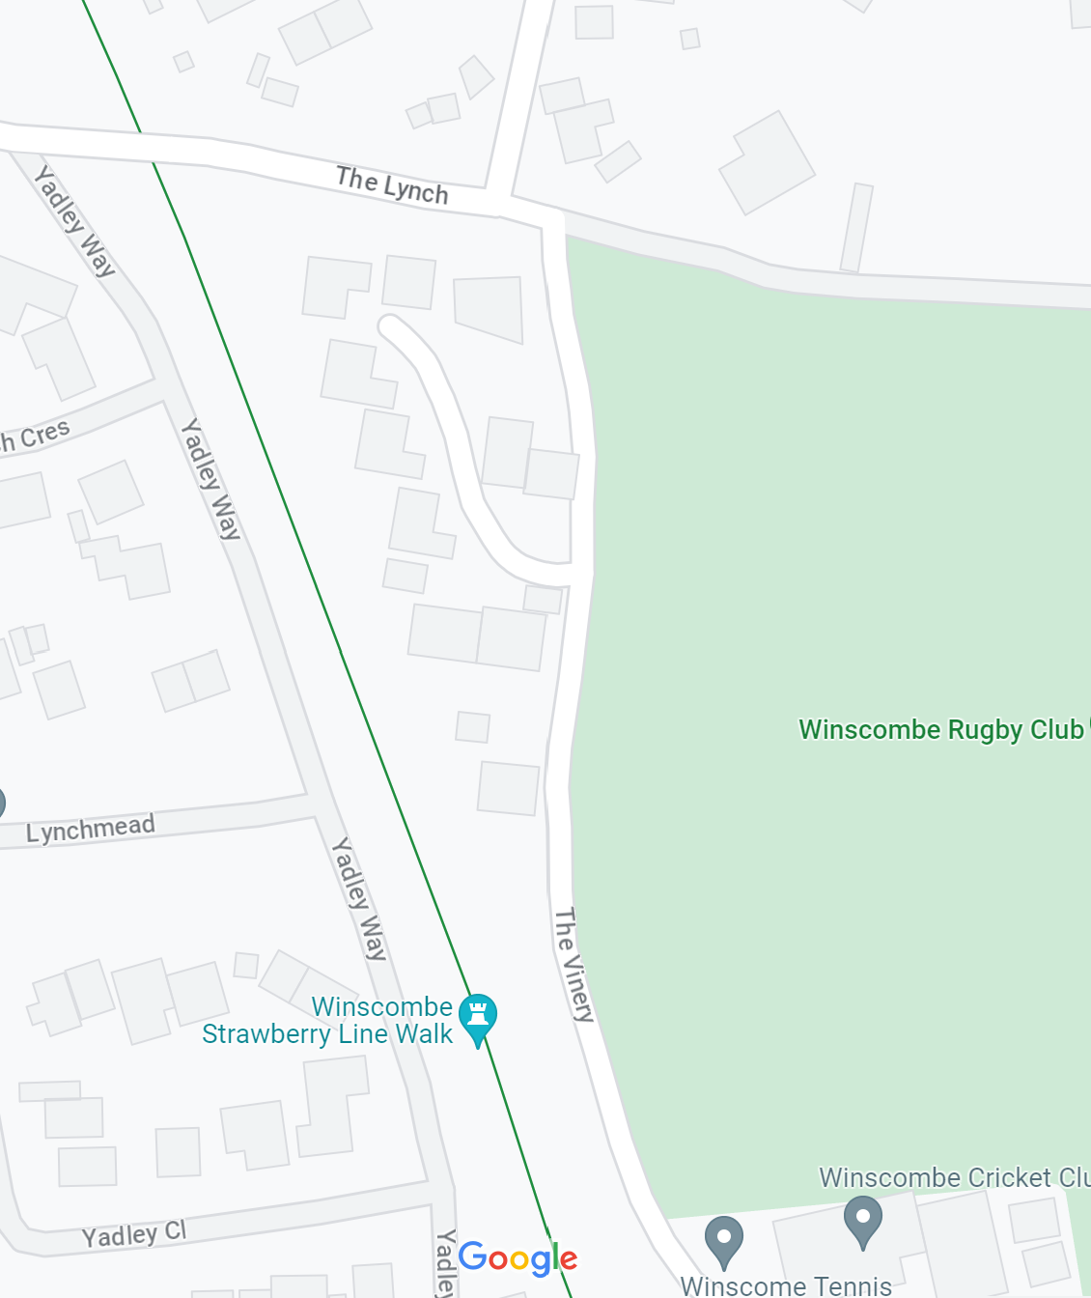
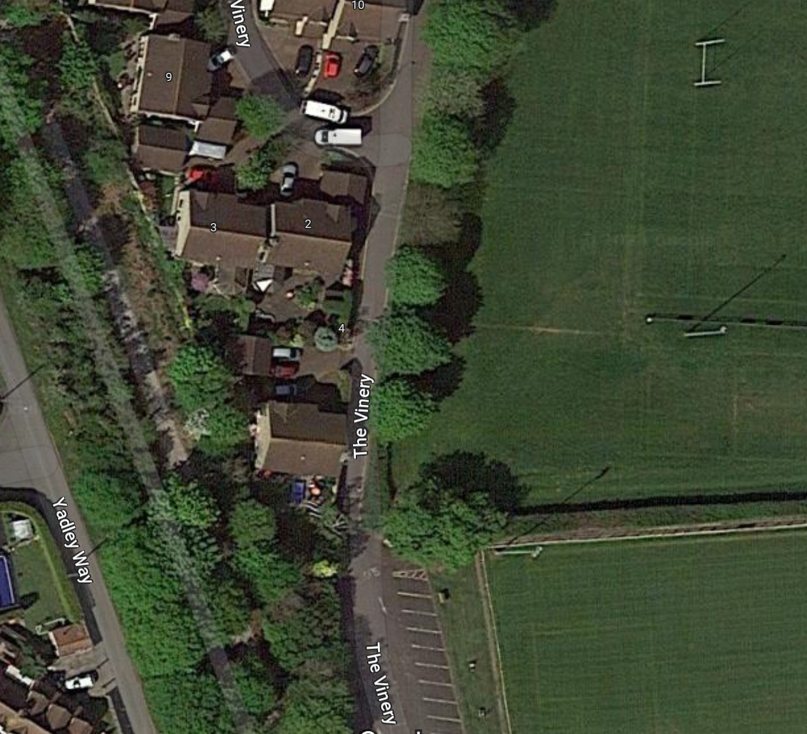
Advance Warning Signs (x2) – To be displayed 10 days prior to commencement of works
This Road And Car Park Will Be Closed For Essential Drainage Works
……/……/2025
For
……..Days
Winscombe & Sandford Parish Council
01934 844 257

Slide 2
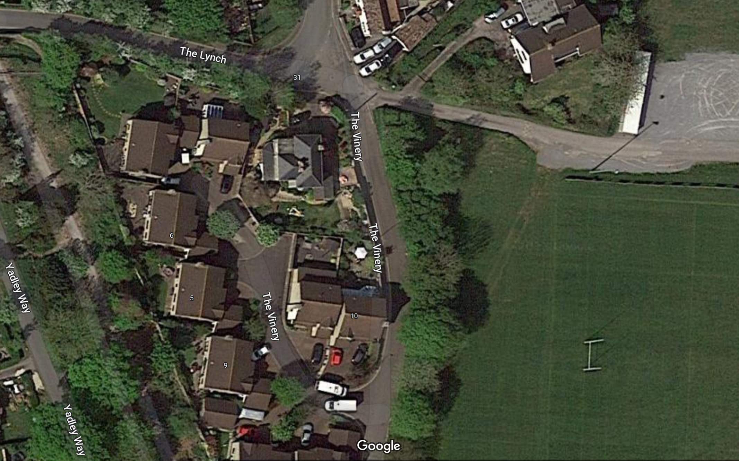
Road
Ahead
Closed
No Access to Recreation Grounds
Alternative Parking

Slide 3
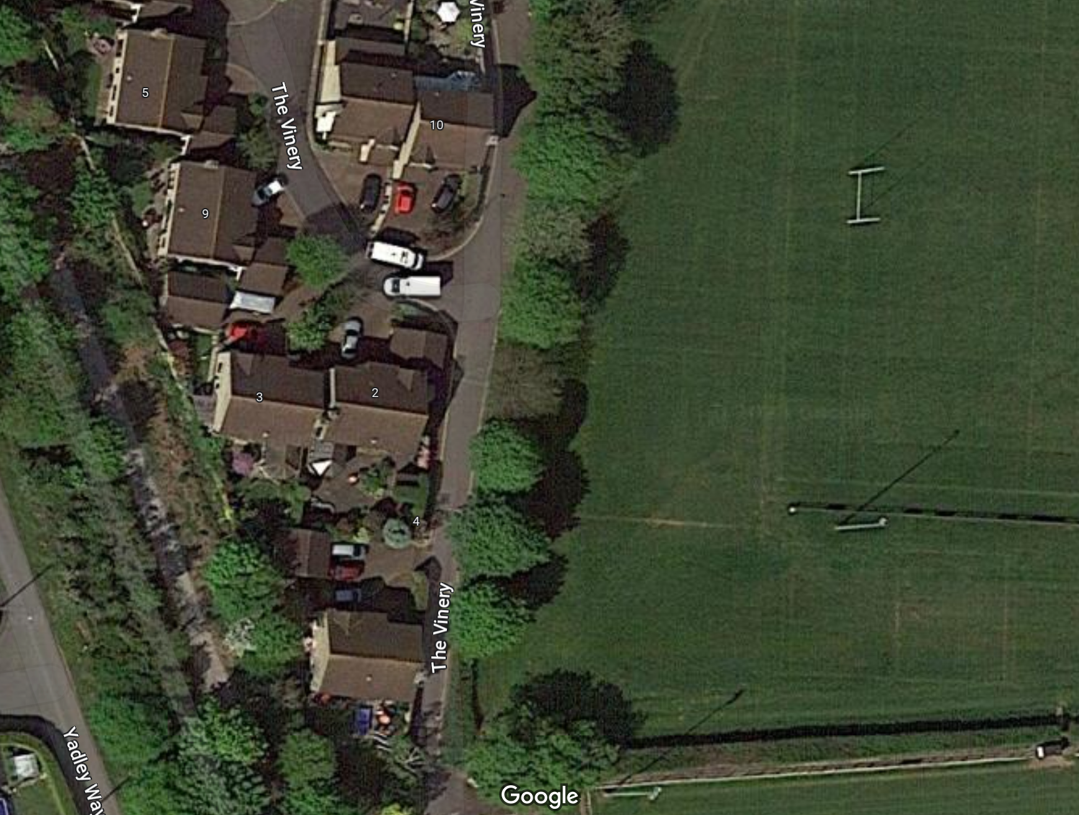
Road
Ahead
Closed
Road
Closed
Our Contractors are working to complete these essential drainage works as soon as possible
Apologies for any inconvenience caused
Winscombe & Sandford Parish Council
01934 844 257

