Slide 1
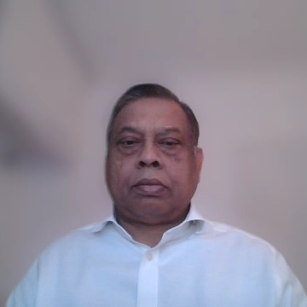
Haringey Council Catering Framework

Slide 2

Catering Framework Opportunity
Apply to join Haringey Council’s Catering Procurement Framework
Access 4-year pipeline of catering opportunities
Focused on micro-businesses and Small and Medium‑Sized Enterprise (SMEs) in Haringey
Multiple Lots available including Civic, Education, Community, Concessions, Vending, and Specialist Catering

Slide 3
What You’ll Need
Registered business in Haringey
Minimum 4-star food hygiene rating
Commitment to sustainability and local sourcing
Compliance with food safety and hygiene standards

Slide 4
The Lots
Lot 1 – Civic & Corporate Catering
Deliver buffets, hot meals, and refreshments for council offices, training events, and formal functions.
Lot 2 – Education Catering
Provide nutritious, compliant school food standards for colleges and youth centres. (Please note: Not school meals)
Lot 3 – Community & Social Event Catering
Serve diverse menus for cultural events, festivals, and outreach programs.
Lot 4 – Concessions (Fixed Outlets)
Operate cafés, kiosks, and food stalls in council premises and public spaces.
Lot 5 – Vending & Grab-and-Go
Supply vending machines, mobile food units, and healthy snack options.
Lot 6 – Specialist & Cultural Catering
Offer authentic cuisines for heritage festivals and specialist dietary needs.

Slide 5
How to Bid
Review the six Lots and decide which ones best fit your business
Prepare required documentation (hygiene rating, business details, etc.)
Submit your application via the gov.uk Tender Portal
https://www.find-tender.service.gov.uk/Notice/008678-2026?
Submission deadline: 9 March 2026,
Award decision date (estimated) April 2026

Slide 6
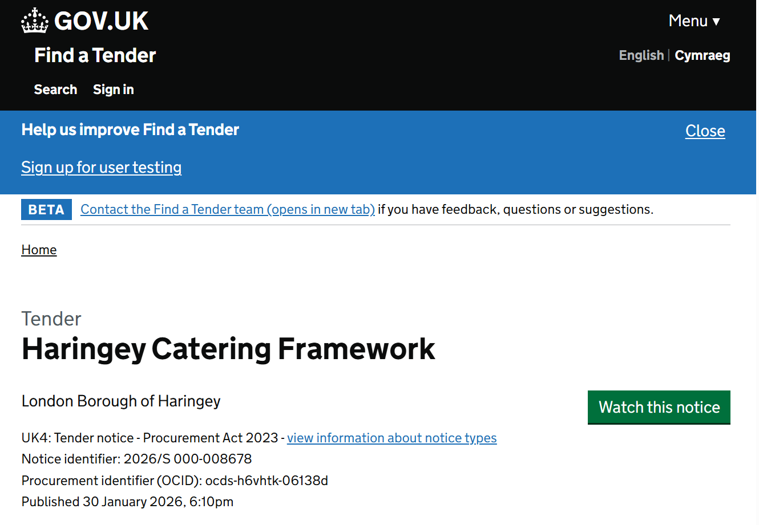
How to Bid – Tender Portal
Submit your application via the gov.uk Tender Portal
https://www.find-tender.service.gov.uk/Notice/008678-2026?

Slide 7
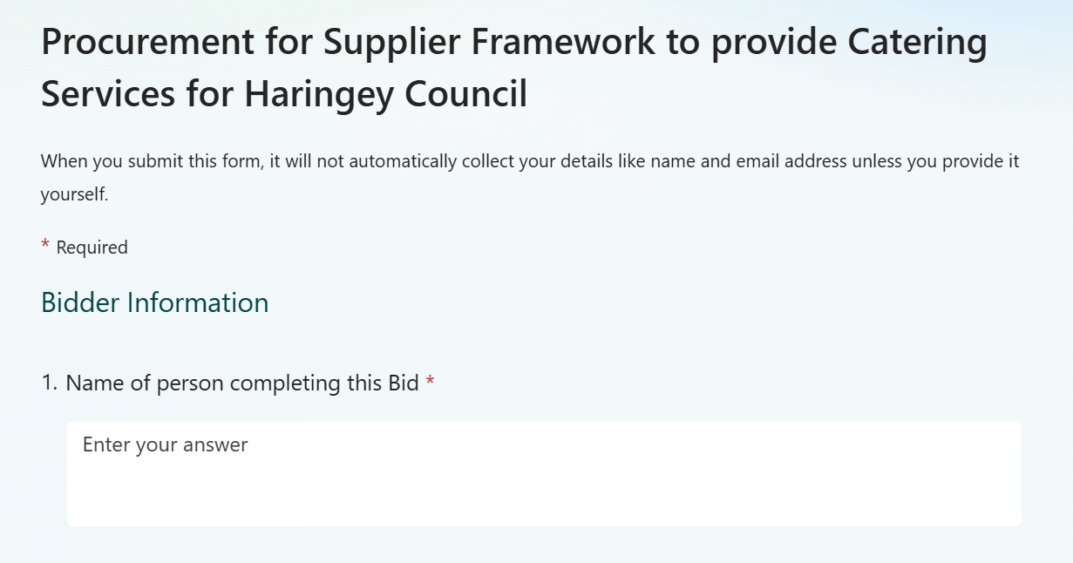
How to Bid – Application form

Slide 8
Support
Submit your application via the gov.uk Tender Portal
https://www.find-tender.service.gov.uk/Notice/008678-2026?
Any queries MUST be submitted via the Tender Portal, and any responses will be uploaded via the portal too.
Please tell other catering businesses of this opportunity

Slide 9
Thank You – we look forward to receiving your bid to join the framework.

